Slide 1

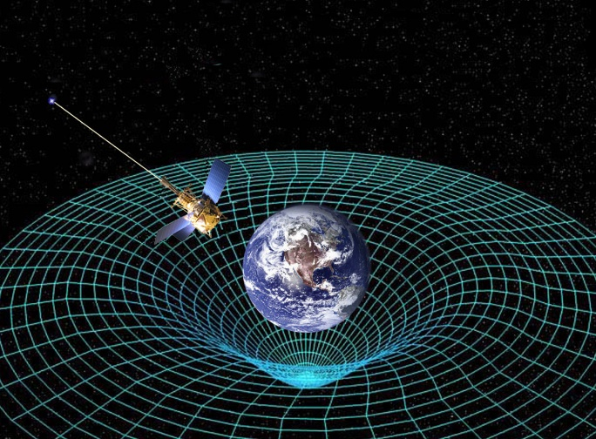
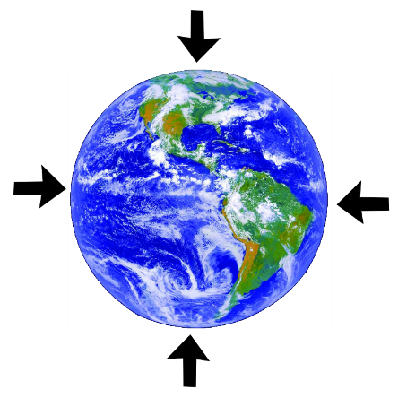

Modern Perspectives on Einstein’s General Theory of Relativity
James H. McNeill, Natural Sciences Department, Middle Georgia State University, Macon, GA 31206
Robert A. Doti, Chemistry and Physics Department, Franklin College, Franklin, IN 46131
James E. Bidlack, Biology Department, University of Central Oklahoma, Edmond, OK 73034
The Mathematics of Einstein’s General Theory of Relativity explains the force of gravity
Einstein’s General Theory of Relativity states that if one is accelerating in a rocket in weightless outer-space at 9.80 m/sec², it is the same force we experience at the surface of our planet earth due to the stretching of space-time by our planet earth.

Slide 2
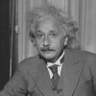
Major difference between Einstein’s Special Theory of Relativity and his General Theory of Relativity
Special theory of relativity states that the speed of light is a universal constant in a inertial frame of reference, such as moving at constant velocity, which is at constant speed in a straight path, or at rest. Thus, one at constant velocity as well as at rest will see a laser beam of light to take a straight horizontal path across their space craft.
General relativity theory states that in an accelerating space craft, or at the surface of a large body of mass such as our earth, one will see that same horizontal laser beam of light take a curved path. The depth of this curved path depends upon how great is the acceleration. At 9.80 m/sec² such a laser beam of light would only bend about 5×10⁻¹⁷ meter after traveling one meter of horizontal distance, practically immeasurable.
Moving at constant velocity or at rest seeing a laser beam of light taking a horizontal straight path.
Bending of a horizontal laser beam of light in an accelerating rocket in outer space or in the equivalent force of gravity on a planet’s surface
Likewise, one in a rotating object would also see a curved path for a straight laser beam of light that correlates with the centrifugal accelerating force they experience during rotational motion

Slide 3
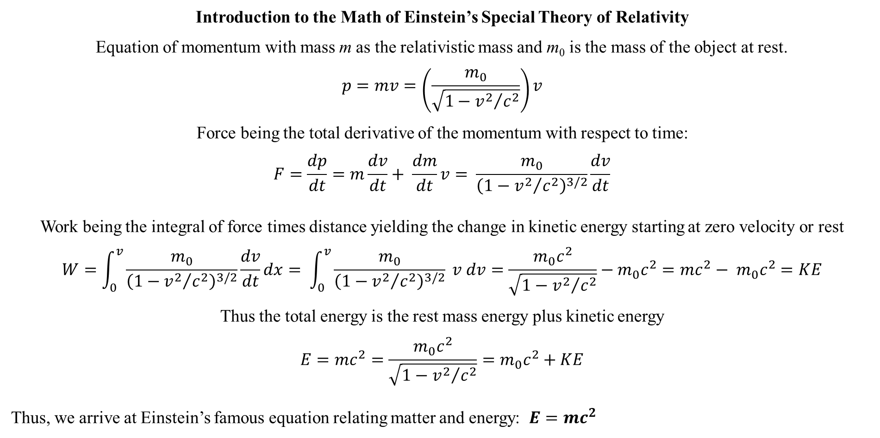
Introduction to the Math of Einstein’s Special Theory of Relativity
Equation of momentum with mass m as the relativistic mass and m₀ is the mass of the object at rest.
$$p=mv=\left(\frac{m_{0}}{\sqrt{1−{v^{2}}/{c^{2}}}}\right)v$$
Force being the total derivative of the momentum with respect to time:
$$F=\frac{dp}{dt}=m\frac{dv}{dt}+ \frac{dm}{dt}v= \frac{m_{0}}{{\left(1−{v^{2}}/{c^{2}}\right)}^{3/2}}\frac{dv}{dt}$$
Work being the integral of force times distance yielding the change in kinetic energy starting at zero velocity or rest
$$W=\int_{0}^{v}{\frac{m_{0}}{{\left(1−{v^{2}}/{c^{2}}\right)}^{3/2}}\frac{dv}{dt}dx}= \int_{0}^{v}{\frac{m_{0}}{{\left(1−{v^{2}}/{c^{2}}\right)}^{3/2}} v dv}=\frac{m_{0}c^{2}}{\sqrt{1−{v^{2}}/{c^{2}}}}−m_{0}c^{2}=mc^{2}− m_{0}c^{2}=KE$$
Thus the total energy is the rest mass energy plus kinetic energy
$$E=mc^{2}=\frac{m_{0}c^{2}}{\sqrt{1−{v^{2}}/{c^{2}}}}=m_{0}c^{2}+KE$$
Thus, we arrive at Einstein’s famous equation relating matter and energy: $E=mc^{2}$

Slide 4
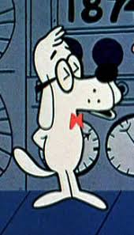
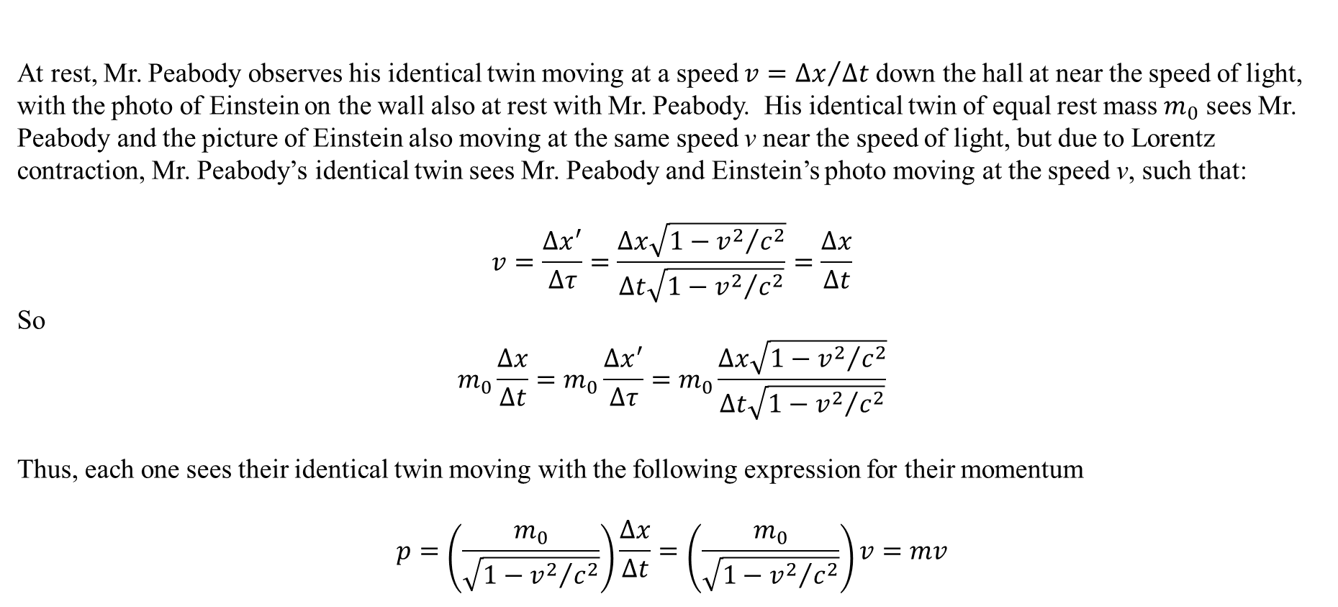
Development of the Mathematics of the Special Theory of Relativity
At rest, Mr. Peabody observes his identical twin moving at a speed $v={∆x}/{∆t}$ down the hall at near the speed of light, with the photo of Einstein on the wall also at rest with Mr. Peabody. His identical twin of equal rest mass $m_{0}$ sees Mr. Peabody and the picture of Einstein also moving at the same speed v near the speed of light, but due to Lorentz contraction, Mr. Peabody’s identical twin sees Mr. Peabody and Einstein’s photo moving at the speed v, such that:
$$v=\frac{Δx^{′}}{Δτ}=\frac{Δx\sqrt{1−{v^{2}}/{c^{2}}}}{Δt\sqrt{1−{v^{2}}/{c^{2}}}}=\frac{Δx}{Δt}$$
So
$$m_{0}\frac{Δx}{Δt}=m_{0}\frac{Δx^{′}}{Δτ}=m_{0}\frac{Δx\sqrt{1−{v^{2}}/{c^{2}}}}{Δt\sqrt{1−{v^{2}}/{c^{2}}}}$$
Thus, each one sees their identical twin moving with the following expression for their momentum
$$p=\left(\frac{m_{0}}{\sqrt{1−{v^{2}}/{c^{2}}}}\right)\frac{Δx}{Δt}=\left(\frac{m_{0}}{\sqrt{1−{v^{2}}/{c^{2}}}}\right)v=mv$$

Slide 5
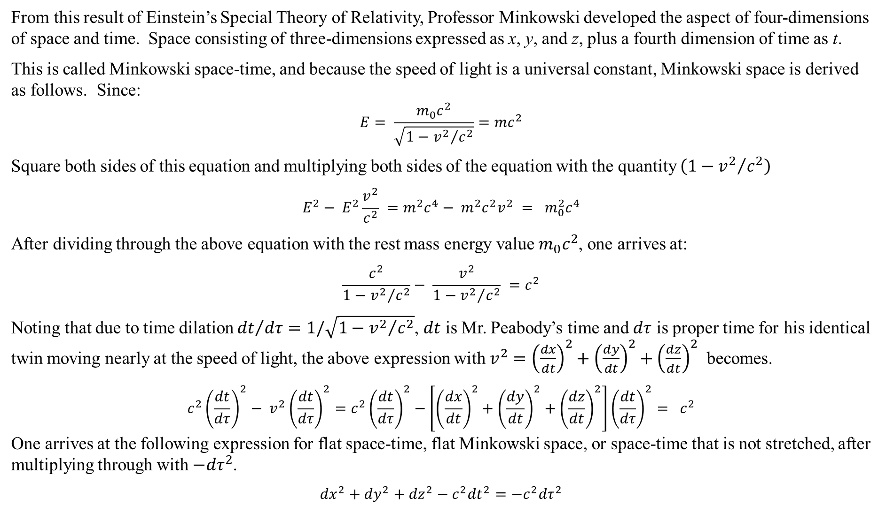
From this result of Einstein’s Special Theory of Relativity, Professor Minkowski developed the aspect of four-dimensions of space and time. Space consisting of three-dimensions expressed as x, y, and z, plus a fourth dimension of time as t.
This is called Minkowski space-time, and because the speed of light is a universal constant, Minkowski space is derived as follows. Since:
$$E= \frac{m_{0}c^{2}}{\sqrt{1−{v^{2}}/{c^{2}}}}=mc^{2}$$
Square both sides of this equation and multiplying both sides of the equation with the quantity $\left(1−{v^{2}}/{c^{2}}\right)$
$$E^{2}− E^{2}\frac{v^{2}}{c^{2}} =m^{2}c^{4}− m^{2}c^{2}v^{2} = m_{0}^{2}c^{4}$$
After dividing through the above equation with the rest mass energy value $m_{0}c^{2}$, one arrives at:
$$\frac{c^{2}}{1−{v^{2}}/{c^{2}}}− \frac{v^{2}}{1−{v^{2}}/{c^{2}}} =c^{2}$$
Noting that due to time dilation ${dt}/{dτ=1/\sqrt{1−{v^{2}}/{c^{2}}}}$, $dt$ is Mr. Peabody’s time and $dτ$ is proper time for his identical twin moving nearly at the speed of light, the above expression with $v^{2}={\left(\frac{dx}{dt}\right)}^{2}+{\left(\frac{dy}{dt}\right)}^{2}+{\left(\frac{dz}{dt}\right)}^{2}$ becomes.
$$c^{2}{\left(\frac{dt}{dτ}\right)}^{2}− v^{2}{\left(\frac{dt}{dτ}\right)}^{2}=c^{2}{\left(\frac{dt}{dτ}\right)}^{2}−\left[{\left(\frac{dx}{dt}\right)}^{2}+{\left(\frac{dy}{dt}\right)}^{2}+{\left(\frac{dz}{dt}\right)}^{2}\right]{\left(\frac{dt}{dτ}\right)}^{2}= c^{2}$$
One arrives at the following expression for flat space-time, flat Minkowski space, or space-time that is not stretched, after multiplying through with ${−dτ}^{2}$.
$${dx}^{2}+{dy}^{2}+{dz}^{2}−c^{2}{dt}^{2}=−c^{2}{dτ}^{2}$$

Slide 6
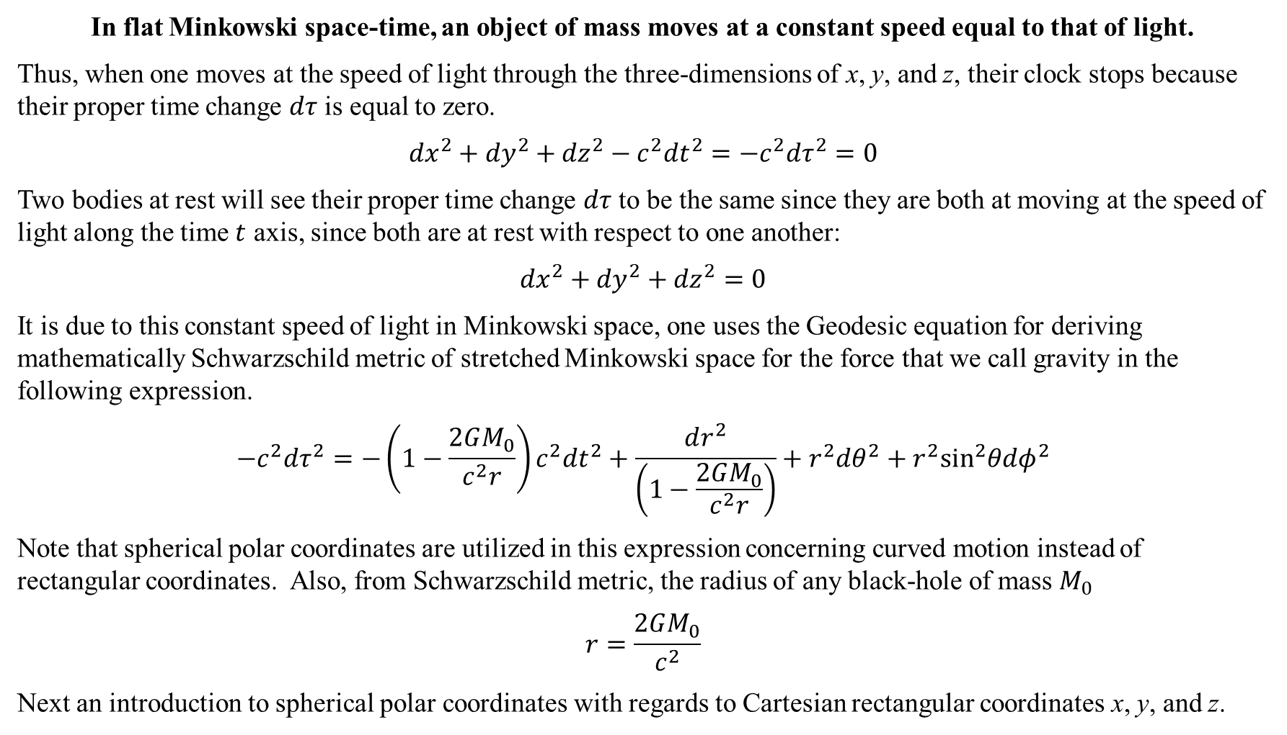
In flat Minkowski space-time, an object of mass moves at a constant speed equal to that of light.
Thus, when one moves at the speed of light through the three-dimensions of x, y, and z, their clock stops because their proper time change $dτ$ is equal to zero.
$${dx}^{2}+{dy}^{2}+{dz}^{2}−c^{2}{dt}^{2}=−c^{2}{dτ}^{2}=0$$
Two bodies at rest will see their proper time change $dτ$ to be the same since they are both at moving at the speed of light along the time $t$ axis, since both are at rest with respect to one another:
$${dx}^{2}+{dy}^{2}+{dz}^{2}=0$$
It is due to this constant speed of light in Minkowski space, one uses the Geodesic equation for deriving mathematically Schwarzschild metric of stretched Minkowski space for the force that we call gravity in the following expression.
$$−c^{2}dτ^{2}=−\left(1−\frac{2GM_{0}}{c^{2}r}\right)c^{2}{dt}^{2}+\frac{dr^{2}}{\left(1−\frac{2GM_{0}}{c^{2}r}\right)}+r^{2}dθ^{2}+r^{2}\sin^{2}θdφ^{2}$$
Note that spherical polar coordinates are utilized in this expression concerning curved motion instead of rectangular coordinates. Also, from Schwarzschild metric, the radius of any black-hole of mass $M_{0}$
$$r=\frac{2GM_{0}}{c^{2}}$$
Next an introduction to spherical polar coordinates with regards to Cartesian rectangular coordinates x, y, and z.

Slide 7
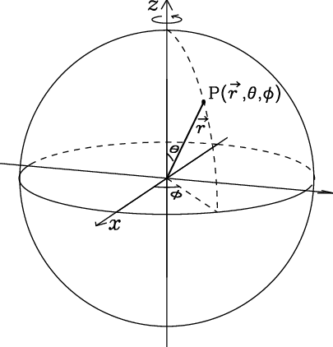
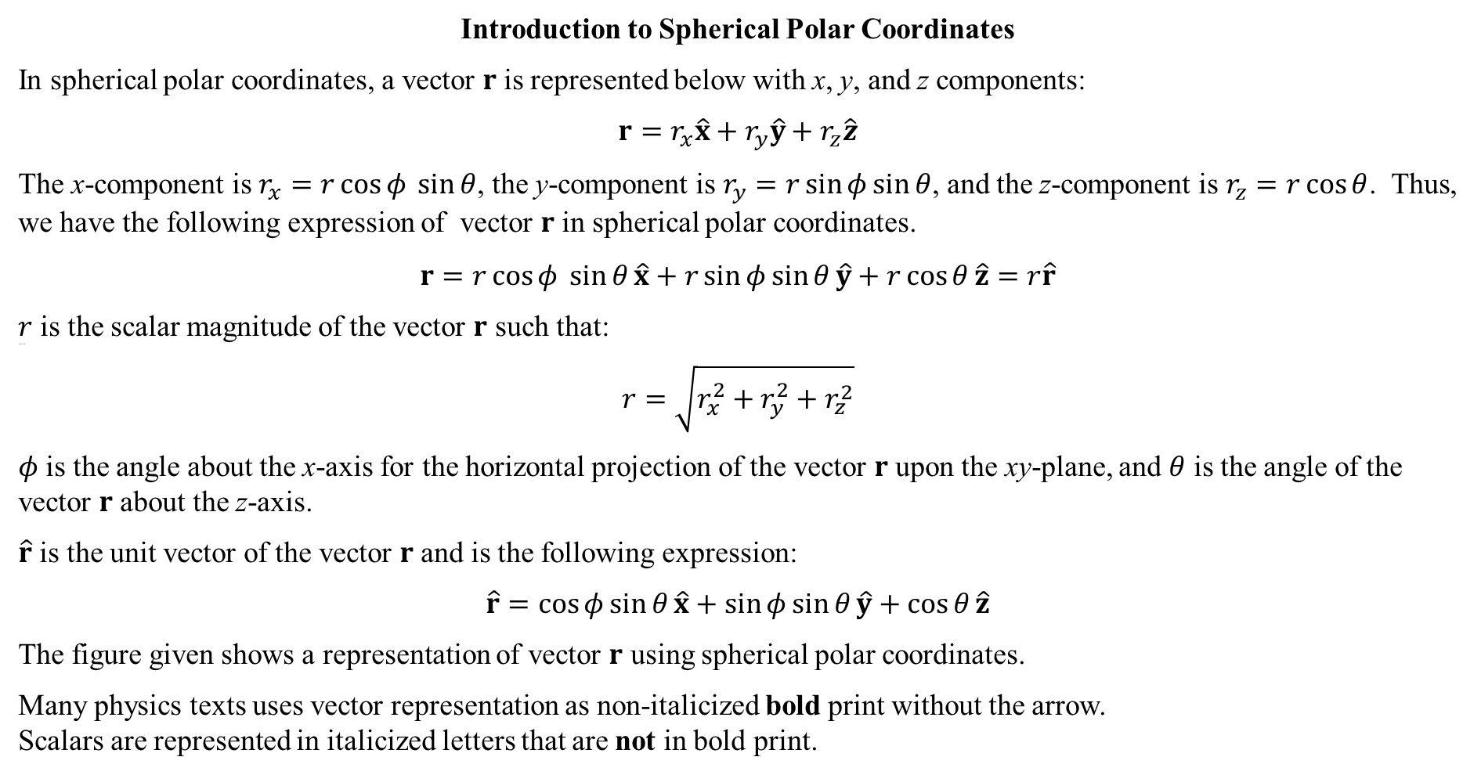
Introduction to Spherical Polar Coordinates
In spherical polar coordinates, a vector $r$ is represented below with x, y, and z components:
$$r=r_{x}\hat{x}+r_{y}\hat{y}+r_{z}\hat{z}$$
The x-component is $r_{x}=r\cos{φ} \sin{θ}$, the y-component is $r_{y}=r\sin{φ}\sin{θ}$, and the z-component is $r_{z}=r\cos{θ}$. Thus, we have the following expression of vector $r$ in spherical polar coordinates.
$$r=r\cos{φ} \sin{θ}\hat{x}+r\sin{φ}\sin{θ}\hat{y}+r\cos{θ}\hat{z}=r\hat{r}$$
$r$ is the scalar magnitude of the vector $r$ such that:
such that
$$r=\sqrt{r_{x}^{2}+r_{y}^{2}+r_{z}^{2}}$$
$φ$ is the angle about the x-axis for the horizontal projection of the vector $r$ upon the xy-plane, and $θ$ is the angle of the vector $r$ about the z-axis.
$\hat{r}$ is the unit vector of the vector $r$ and is the following expression:
$$\hat{r}=\cos{φ}\sin{θ}\hat{x}+\sin{φ}\sin{θ}\hat{y}+\cos{θ}\hat{z}$$
The figure given shows a representation of vector $r$ using spherical polar coordinates.
Many physics texts uses vector representation as non-italicized bold print without the arrow.
Scalars are represented in italicized letters that are not in bold print.

Slide 8
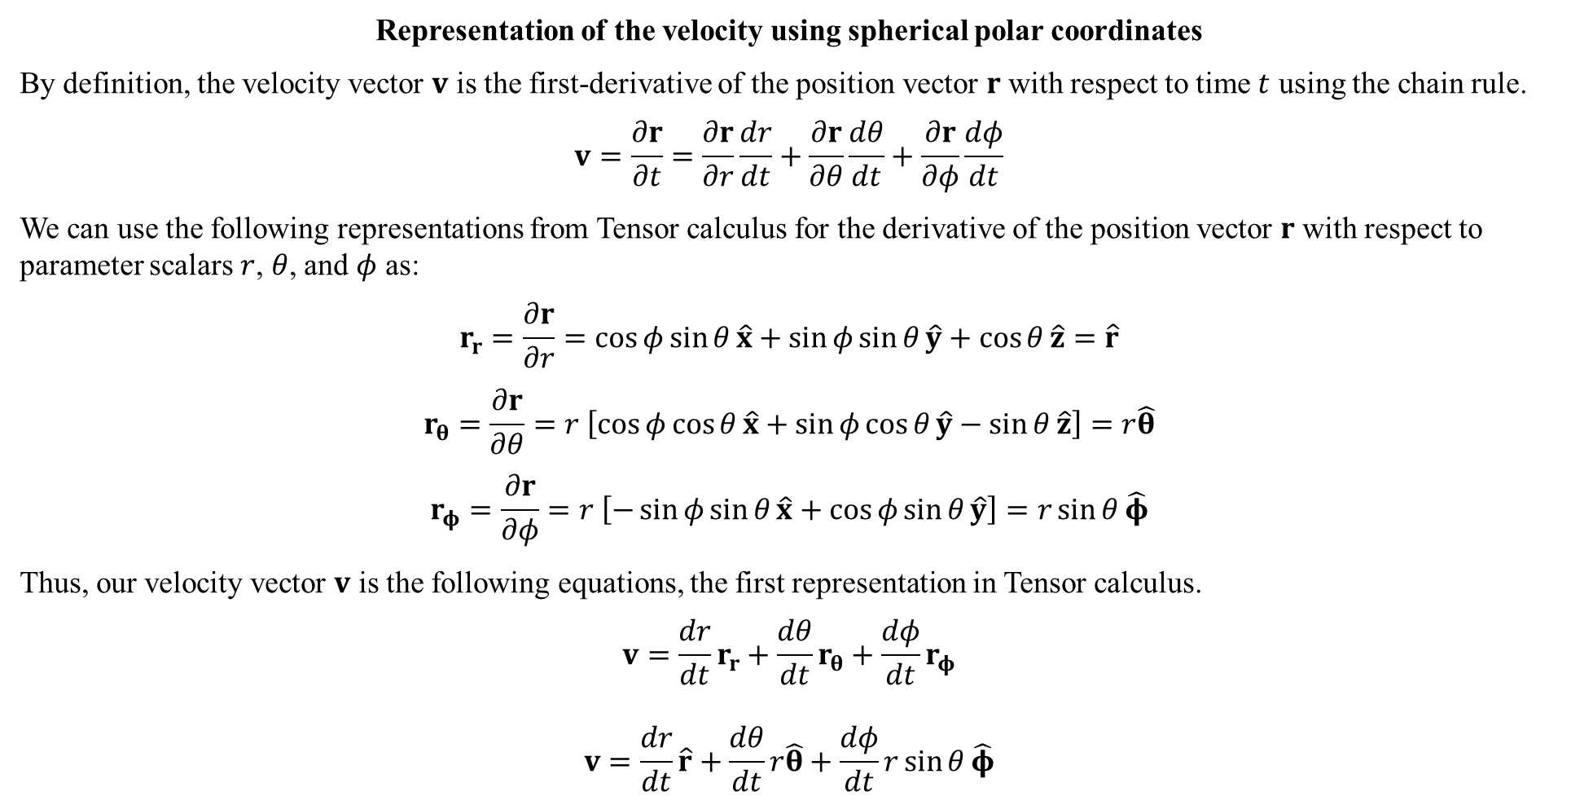
Representation of the velocity using spherical polar coordinates
By definition, the velocity vector $v$ is the first-derivative of the position vector $r$ with respect to time $t$ using the chain rule.
$$v=\frac{∂r}{∂t}=\frac{∂r}{∂r}\frac{dr}{dt}+\frac{∂r}{∂θ}\frac{dθ}{dt}+\frac{∂r}{∂φ}\frac{dφ}{dt}$$
We can use the following representations from Tensor calculus for the derivative of the position vector $r$ with respect to parameter scalars $r$, $θ$, and $φ$ as:
$$r_{r}=\frac{∂r}{∂r}=\cos{φ}\sin{θ}\hat{x}+\sin{φ}\sin{θ}\hat{y}+\cos{θ}\hat{z}=\hat{r}$$
$$r_{θ}=\frac{∂r}{∂θ}=r \left[\cos{φ}\cos{θ}\hat{x}+\sin{φ}\cos{θ}\hat{y}−\sin{θ}\hat{z}\right]=r\hat{θ}$$
$$r_{φ}=\frac{∂r}{∂φ}=r \left[−\sin{φ}\sin{θ}\hat{x}+\cos{φ}\sin{θ}\hat{y}\right]=r\sin{θ}\hat{φ}$$
Thus, our velocity vector $v$ is the following equations, the first representation in Tensor calculus.
$$v=\frac{dr}{dt}r_{r}+\frac{dθ}{dt}r_{θ}+\frac{dφ}{dt}r_{φ}$$
$$v=\frac{dr}{dt}\hat{r}+\frac{dθ}{dt}r\hat{θ}+\frac{dφ}{dt}r\sin{θ}\hat{φ}$$

Slide 9
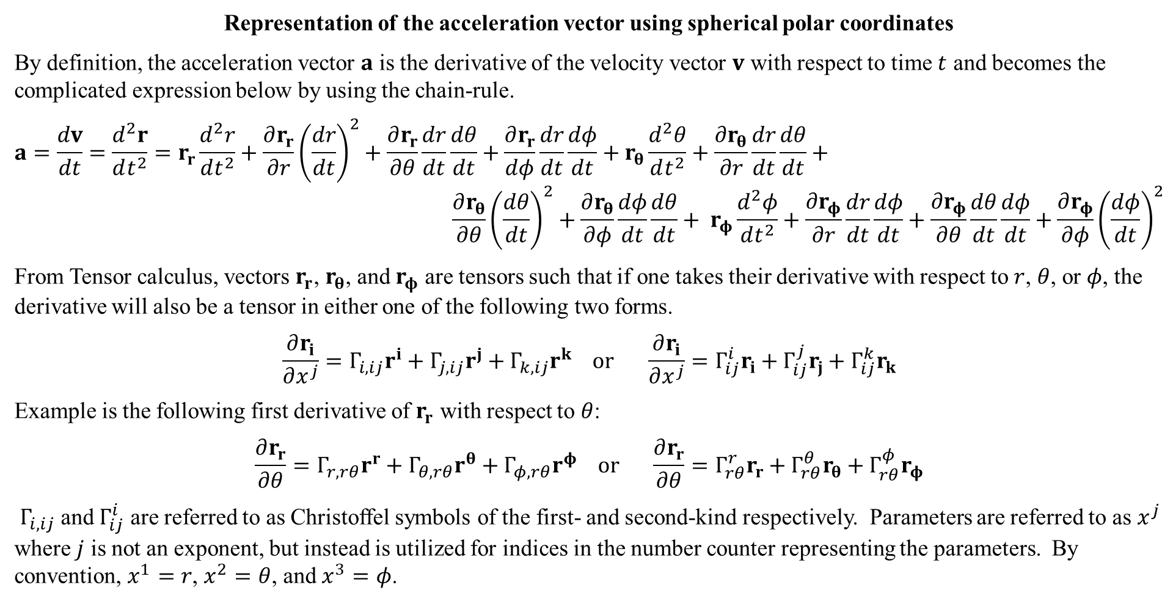
Representation of the acceleration vector using spherical polar coordinates
By definition, the acceleration vector $a$ is the derivative of the velocity vector $v$ with respect to time $t$ and becomes the complicated expression below by using the chain-rule.
$$a=\frac{dv}{dt}=\frac{d^{2}r}{dt^{2}}=r_{r}\frac{d^{2}r}{dt^{2}}+\frac{∂r_{r}}{∂r}{\left(\frac{dr}{dt}\right)}^{2}+\frac{∂r_{r}}{∂θ}\frac{dr}{dt}\frac{dθ}{dt}+\frac{∂r_{r}}{dφ}\frac{dr}{dt}\frac{dφ}{dt}+r_{θ}\frac{d^{2}θ}{dt^{2}}+\frac{∂r_{θ}}{∂r}\frac{dr}{dt}\frac{dθ}{dt}+$$
$$\frac{∂r_{θ}}{∂θ}{\left(\frac{dθ}{dt}\right)}^{2}+\frac{∂r_{θ}}{∂φ}\frac{dφ}{dt}\frac{dθ}{dt}+ r_{φ}\frac{d^{2}φ}{dt^{2}}+\frac{∂r_{φ}}{∂r}\frac{dr}{dt}\frac{dφ}{dt}+\frac{{∂r}_{φ}}{∂θ}\frac{dθ}{dt}\frac{dφ}{dt}+\frac{∂r_{φ}}{∂φ}{\left(\frac{dφ}{dt}\right)}^{2}$$
From Tensor calculus, vectors $r_{r}$, $r_{θ}$, and $r_{φ}$ are tensors such that if one takes their derivative with respect to $r$, $θ$, or $φ$, the derivative will also be a tensor in either one of the following two forms.
$$\frac{∂r_{i}}{∂x^{j}}=Γ_{i,ij}r^{i}+Γ_{j,ij}r^{j}+Γ_{k,ij}r^{k} or \frac{∂r_{i}}{∂x^{j}}=Γ_{ij}^{i}r_{i}+Γ_{ij}^{j}r_{j}+Γ_{ij}^{k}r_{k}$$
Example is the following first derivative of $r_{r}$ with respect to $θ$:
$$\frac{∂r_{r}}{∂θ}=Γ_{r,rθ}r^{r}+Γ_{θ,rθ}r^{θ}+Γ_{φ,rθ}r^{φ} or \frac{∂r_{r}}{∂θ}=Γ_{rθ}^{r}r_{r}+Γ_{rθ}^{θ}r_{θ}+Γ_{rθ}^{φ}r_{φ}$$
$Γ_{i,ij}$ and $Γ_{ij}^{i}$ are referred to as Christoffel symbols of the first- and second-kind respectively. Parameters are referred to as $x^{j}$ where $j$ is not an exponent, but instead is utilized for indices in the number counter representing the parameters. By convention, $x^{1}=r$, $x^{2}=θ$, and $x^{3}=φ$.

Slide 10
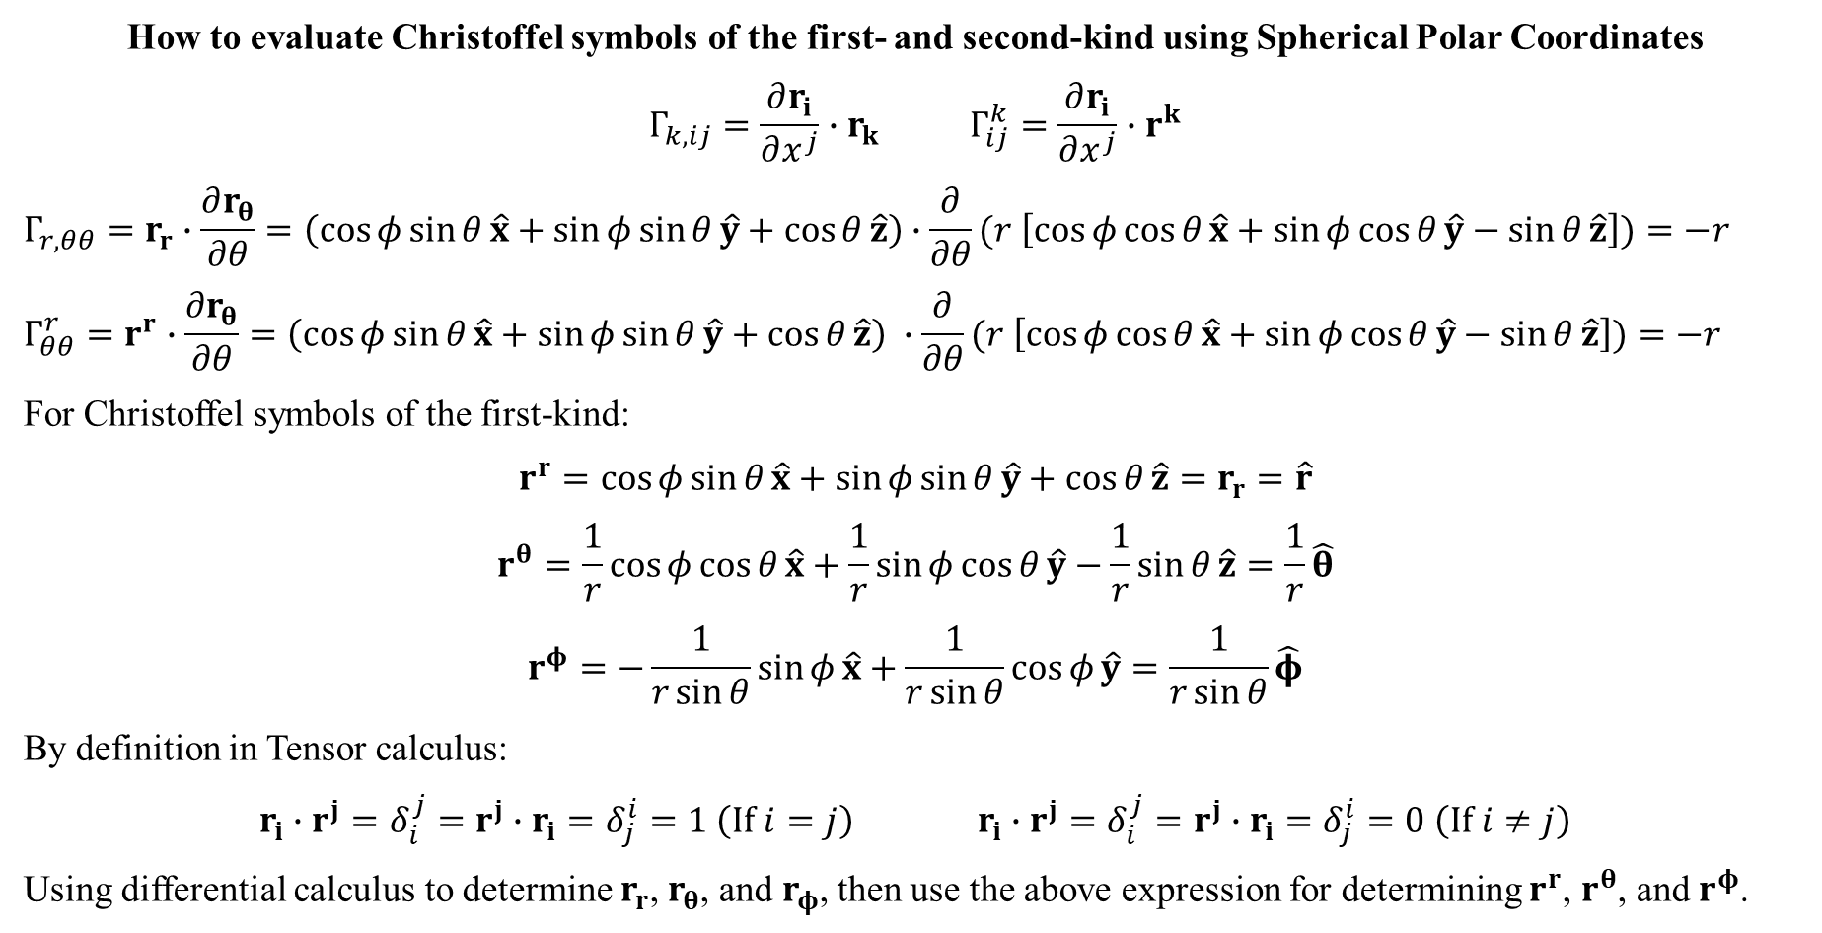
How to evaluate Christoffel symbols of the first- and second-kind using Spherical Polar Coordinates
$$Γ_{k,ij}=\frac{∂r_{i}}{∂x^{j}}∙r_{k} Γ_{ij}^{k}=\frac{∂r_{i}}{∂x^{j}}∙r^{k}$$
$$Γ_{r,θθ}=r_{r}∙\frac{∂r_{θ}}{∂θ}=\left(\cos{φ}\sin{θ}\hat{x}+\sin{φ}\sin{θ}\hat{y}+\cos{θ}\hat{z}\right)∙\frac{∂}{∂θ}(r \left[\cos{φ}\cos{θ}\hat{x}+\sin{φ}\cos{θ}\hat{y}−\sin{θ}\hat{z}\right])=−r$$
$$Γ_{θθ}^{r}=r^{r}∙\frac{∂r_{θ}}{∂θ}=\left(\cos{φ}\sin{θ}\hat{x}+\sin{φ}\sin{θ}\hat{y}+\cos{θ}\hat{z}\right) ∙\frac{∂}{∂θ}(r \left[\cos{φ}\cos{θ}\hat{x}+\sin{φ}\cos{θ}\hat{y}−\sin{θ}\hat{z}\right])=−r$$
For Christoffel symbols of the first-kind:
$$r^{r}=\cos{φ}\sin{θ}\hat{x}+\sin{φ}\sin{θ}\hat{y}+\cos{θ}\hat{z}=r_{r}=\hat{r}$$
$$r^{θ}=\frac{1}{r}\cos{φ}\cos{θ}\hat{x}+\frac{1}{r}\sin{φ}\cos{θ}\hat{y}−\frac{1}{r}\sin{θ}\hat{z}=\frac{1}{r}\hat{θ}$$
$$r^{φ}=−\frac{1}{r\sin{θ}}\sin{φ}\hat{x}+\frac{1}{r\sin{θ}}\cos{φ}\hat{y}=\frac{1}{r\sin{θ}}\hat{φ}$$
By definition in Tensor calculus:
$$r_{i}∙r^{j}=δ_{i}^{j}=r^{j}∙r_{i}=δ_{j}^{i}=1 \left(If i=j\right) r_{i}∙r^{j}=δ_{i}^{j}=r^{j}∙r_{i}=δ_{j}^{i}=0 \left(If i≠j\right)$$
Using differential calculus to determine $r_{r}$, $r_{θ}$, and $r_{φ}$, then use the above expression for determining $r^{r}$, $r^{θ}$, and $r^{φ}$.

Slide 11
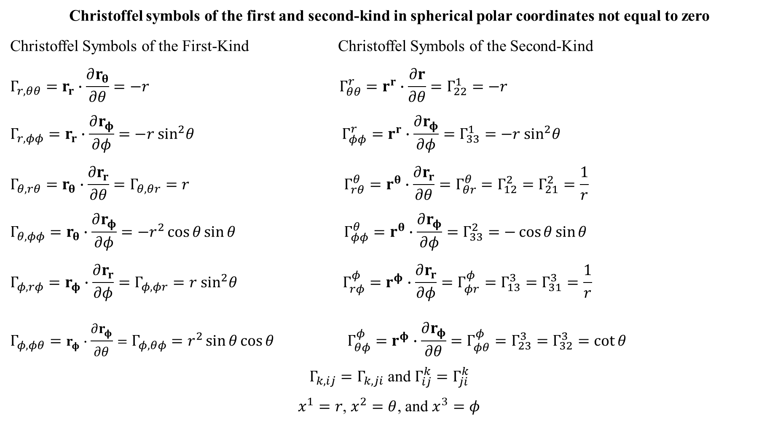
Christoffel symbols of the first and second-kind in spherical polar coordinates not equal to zero
Christoffel Symbols of the First-Kind Christoffel Symbols of the Second-Kind
$$Γ_{r,θθ}=r_{r}∙\frac{∂r_{θ}}{∂θ}=−r Γ_{θθ}^{r}=r^{r}∙\frac{∂r}{∂θ}=Γ_{22}^{1}=−r$$
$$Γ_{r,φφ}=r_{r}∙\frac{∂r_{φ}}{∂φ}=−r \sin^{2}θ Γ_{φφ}^{r}=r^{r}∙\frac{∂r_{φ}}{∂φ}=Γ_{33}^{1}=−r \sin^{2}θ$$
$$Γ_{θ,rθ}=r_{θ}∙\frac{∂r_{r}}{∂θ}=Γ_{θ,θr}=r Γ_{rθ}^{θ}=r^{θ}∙\frac{∂r_{r}}{∂θ}=Γ_{θr}^{θ}=Γ_{12}^{2}=Γ_{21}^{2}=\frac{1}{r}$$
$$Γ_{θ,φφ}=r_{θ}∙\frac{∂r_{φ}}{∂φ}=−r^{2}\cos{θ}\sin{θ} Γ_{φφ}^{θ}=r^{θ}∙\frac{∂r_{φ}}{∂φ}=Γ_{33}^{2}=−\cos{θ}\sin{θ}$$
$$Γ_{φ,rφ}=r_{φ}∙\frac{∂r_{r}}{∂φ}=Γ_{φ,φr}=r \sin^{2}θ Γ_{rφ}^{φ}=r^{φ}∙\frac{∂r_{r}}{∂φ}=Γ_{φr}^{φ}=Γ_{13}^{3}=Γ_{31}^{3}=\frac{1}{r}$$
$$Γ_{φ,φθ}=r_{φ}∙\frac{∂r_{φ}}{∂θ}=Γ_{φ,θφ}=r^{2}\sin{θ}\cos{θ} Γ_{θφ}^{φ}=r^{φ}∙\frac{∂r_{φ}}{∂θ}=Γ_{φθ}^{φ}=Γ_{23}^{3}=Γ_{32}^{3}=\cot{θ}$$
$Γ_{k,ij}=Γ_{k,ji}$ and $Γ_{ij}^{k}=Γ_{ji}^{k}$
$x^{1}=r$, $x^{2}=θ$, and $x^{3}=φ$

Slide 12
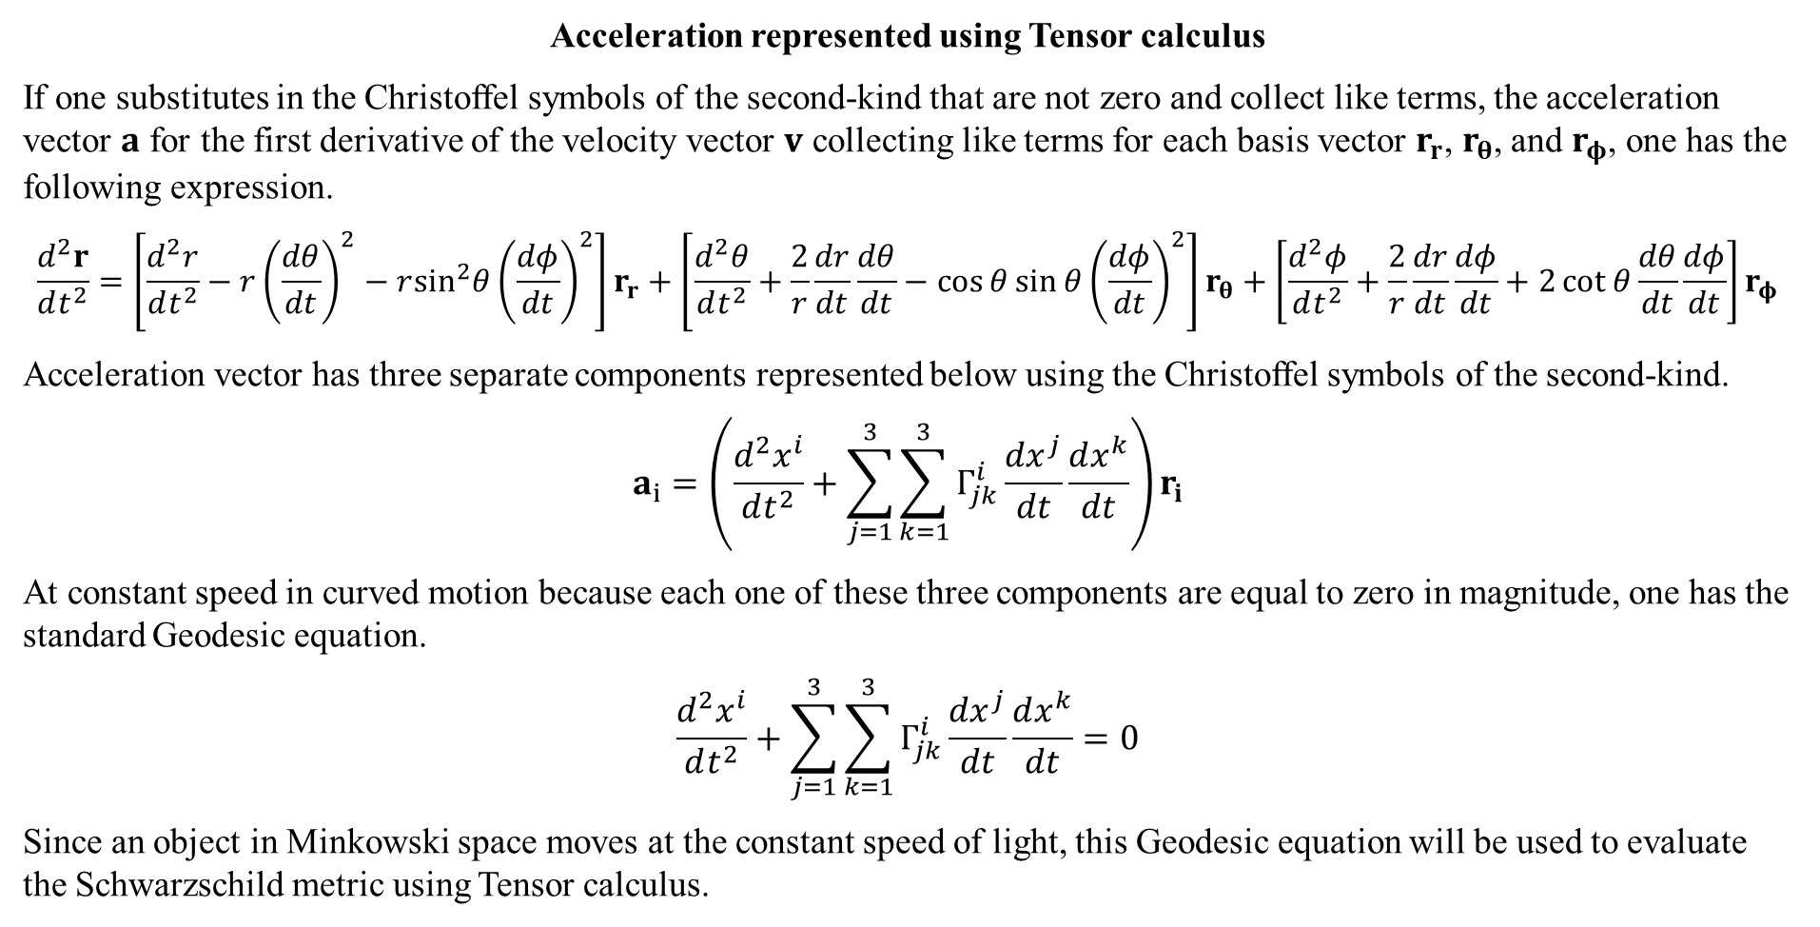
Acceleration represented using Tensor calculus
If one substitutes in the Christoffel symbols of the second-kind that are not zero and collect like terms, the acceleration vector $a$ for the first derivative of the velocity vector $v$ collecting like terms for each basis vector $r_{r}$, $r_{θ}$, and $r_{φ}$, one has the following expression.
$$\frac{d^{2}r}{dt^{2}}=\left[\frac{d^{2}r}{dt^{2}}−r{\left(\frac{dθ}{dt}\right)}^{2}−r\sin^{2}θ{\left(\frac{dφ}{dt}\right)}^{2}\right]r_{r}+\left[\frac{d^{2}θ}{dt^{2}}+\frac{2}{r}\frac{dr}{dt}\frac{dθ}{dt}−\cos{θ}\sin{θ}{\left(\frac{dφ}{dt}\right)}^{2}\right]r_{θ}+\left[\frac{d^{2}φ}{dt^{2}}+\frac{2}{r}\frac{dr}{dt}\frac{dφ}{dt}+2\cot{θ}\frac{dθ}{dt}\frac{dφ}{dt}\right]r_{φ}$$
Acceleration vector has three separate components represented below using the Christoffel symbols of the second-kind.
$$a_{i}=\left(\frac{d^{2}x^{i}}{dt^{2}}+\sum_{j=1}^{3}{\sum_{k=1}^{3}{Γ_{jk}^{i}\frac{dx^{j}}{dt}}}\frac{dx^{k}}{dt}\right)r_{i}$$
At constant speed in curved motion because each one of these three components are equal to zero in magnitude, one has the standard Geodesic equation.
$$\frac{d^{2}x^{i}}{dt^{2}}+\sum_{j=1}^{3}{\sum_{k=1}^{3}{Γ_{jk}^{i}\frac{dx^{j}}{dt}}}\frac{dx^{k}}{dt}=0$$
Since an object in Minkowski space moves at the constant speed of light, this Geodesic equation will be used to evaluate the Schwarzschild metric using Tensor calculus.

Slide 13
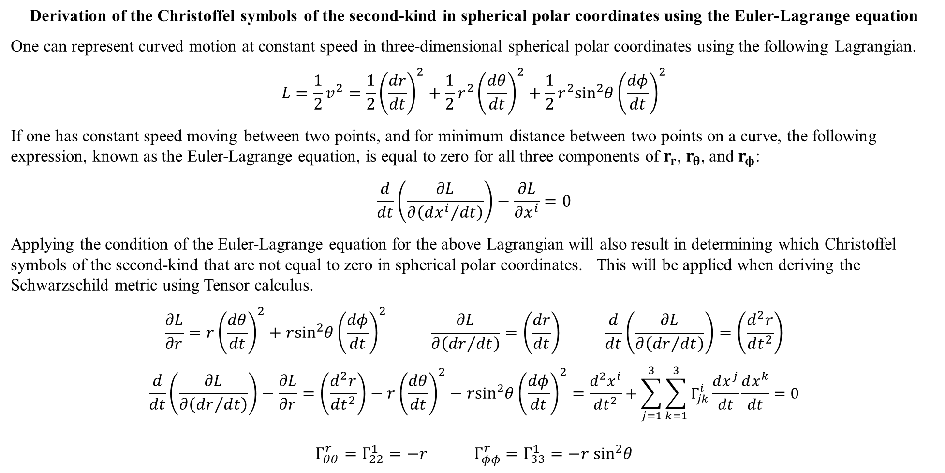
Derivation of the Christoffel symbols of the second-kind in spherical polar coordinates using the Euler-Lagrange equation
One can represent curved motion at constant speed in three-dimensional spherical polar coordinates using the following Lagrangian.
$$L=\frac{1}{2}v^{2}=\frac{1}{2}{\left(\frac{dr}{dt}\right)}^{2}+\frac{1}{2}r^{2}{\left(\frac{dθ}{dt}\right)}^{2}+\frac{1}{2}r^{2}\sin^{2}θ{\left(\frac{dφ}{dt}\right)}^{2}$$
If one has constant speed moving between two points, and for minimum distance between two points on a curve, the following expression, known as the Euler-Lagrange equation, is equal to zero for all three components of $r_{r}$, $r_{θ}$, and $r_{φ}$:
$$\frac{d}{dt}\left(\frac{∂L}{∂\left({dx^{i}}/{dt}\right)}\right)−\frac{∂L}{∂x^{i}}=0$$
Applying the condition of the Euler-Lagrange equation for the above Lagrangian will also result in determining which Christoffel symbols of the second-kind that are not equal to zero in spherical polar coordinates. This will be applied when deriving the Schwarzschild metric using Tensor calculus.
$$\frac{∂L}{∂r}=r{\left(\frac{dθ}{dt}\right)}^{2}+r\sin^{2}θ{\left(\frac{dφ}{dt}\right)}^{2} \frac{∂L}{∂\left({dr}/{dt}\right)}=\left(\frac{dr}{dt}\right) \frac{d}{dt}\left(\frac{∂L}{∂\left({dr}/{dt}\right)}\right)=\left(\frac{d^{2}r}{dt^{2}}\right)$$
$$\frac{d}{dt}\left(\frac{∂L}{∂\left({dr}/{dt}\right)}\right)−\frac{∂L}{∂r}=\left(\frac{d^{2}r}{dt^{2}}\right)−r{\left(\frac{dθ}{dt}\right)}^{2}−r\sin^{2}θ{\left(\frac{dφ}{dt}\right)}^{2}=\frac{d^{2}x^{i}}{dt^{2}}+\sum_{j=1}^{3}{\sum_{k=1}^{3}{Γ_{jk}^{i}\frac{dx^{j}}{dt}}}\frac{dx^{k}}{dt}=0$$
$$Γ_{θθ}^{r}=Γ_{22}^{1}=−r Γ_{φφ}^{r}=Γ_{33}^{1}=−r \sin^{2}θ$$

Slide 14
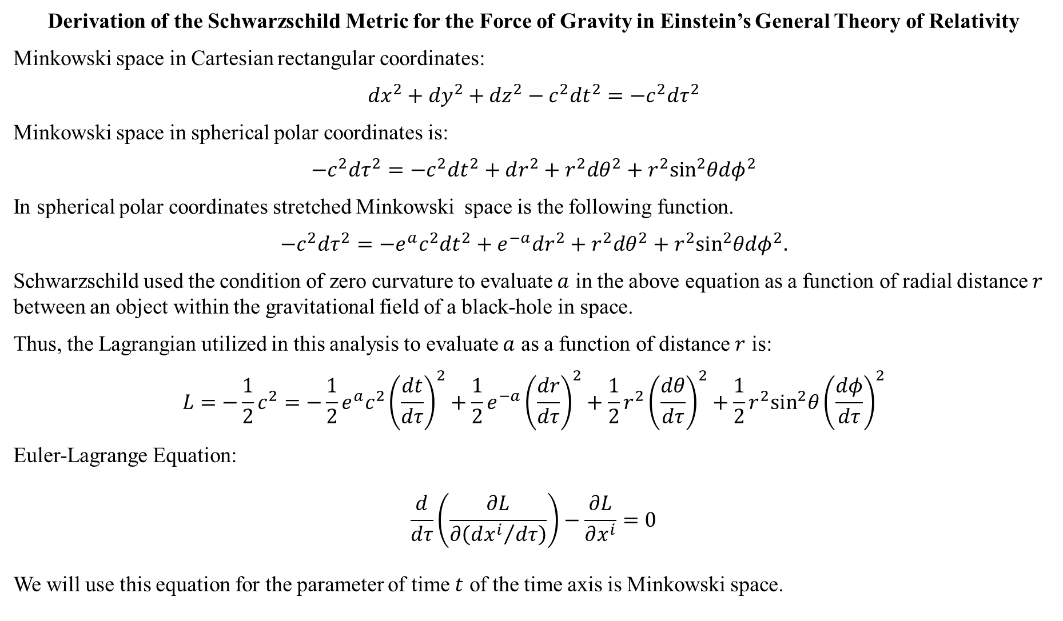
Derivation of the Schwarzschild Metric for the Force of Gravity in Einstein’s General Theory of Relativity
Minkowski space in Cartesian rectangular coordinates:
$${dx}^{2}+{dy}^{2}+{dz}^{2}−c^{2}{dt}^{2}=−c^{2}{dτ}^{2}$$
Minkowski space in spherical polar coordinates is:
$$−c^{2}dτ^{2}=−c^{2}dt^{2}+dr^{2}+r^{2}dθ^{2}+r^{2}\sin^{2}θdφ^{2}$$
In spherical polar coordinates stretched Minkowski space is the following function.
$$−c^{2}dτ^{2}=−e^{a}c^{2}dt^{2}+e^{−a}dr^{2}+r^{2}dθ^{2}+r^{2}\sin^{2}θdφ^{2}.$$
Schwarzschild used the condition of zero curvature to evaluate $a$ in the above equation as a function of radial distance $r$ between an object within the gravitational field of a black-hole in space.
Thus, the Lagrangian utilized in this analysis to evaluate $a$ as a function of distance $r$ is:
$$L=−\frac{1}{2}c^{2}=−\frac{1}{2}e^{a}c^{2}{\left(\frac{dt}{dτ}\right)}^{2}+\frac{1}{2}e^{−a}{\left(\frac{dr}{dτ}\right)}^{2}+\frac{1}{2}r^{2}{\left(\frac{dθ}{dτ}\right)}^{2}+\frac{1}{2}r^{2}\sin^{2}θ{\left(\frac{dφ}{dτ}\right)}^{2}$$
Euler-Lagrange Equation:
$$\frac{d}{dτ}\left(\frac{∂L}{∂\left({dx^{i}}/{dτ}\right)}\right)−\frac{∂L}{∂x^{i}}=0$$
We will use this equation for the parameter of time $t$ of the time axis is Minkowski space.

Slide 15
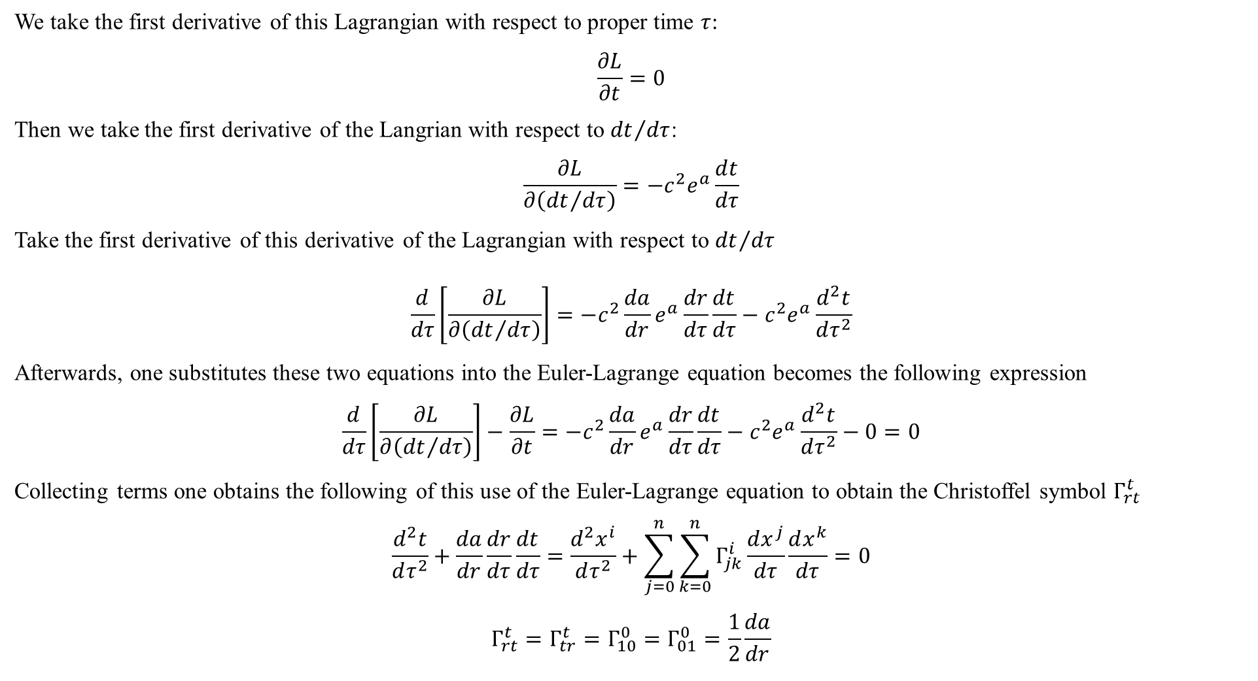
We take the first derivative of this Lagrangian with respect to proper time $τ$:
$$\frac{∂L}{∂t}=0$$
Then we take the first derivative of the Langrian with respect to ${dt}/{dτ}$:
$$\frac{∂L}{∂\left({dt}/{dτ}\right)}=−c^{2}e^{a}\frac{dt}{dτ}$$
Take the first derivative of this derivative of the Lagrangian with respect to ${dt}/{dτ}$
$$\frac{d}{dτ}\left[\frac{∂L}{∂\left({dt}/{dτ}\right)}\right]=−c^{2}\frac{da}{dr}e^{a}\frac{dr}{dτ}\frac{dt}{dτ}−c^{2}e^{a}\frac{d^{2}t}{dτ^{2}}$$
Afterwards, one substitutes these two equations into the Euler-Lagrange equation becomes the following expression
$$\frac{d}{dτ}\left[\frac{∂L}{∂\left({dt}/{dτ}\right)}\right]−\frac{∂L}{∂t}=−c^{2}\frac{da}{dr}e^{a}\frac{dr}{dτ}\frac{dt}{dτ}−c^{2}e^{a}\frac{d^{2}t}{dτ^{2}}−0=0$$
Collecting terms one obtains the following of this use of the Euler-Lagrange equation to obtain the Christoffel symbol $Γ_{rt}^{t}$
$$\frac{d^{2}t}{dτ^{2}}+\frac{da}{dr}\frac{dr}{dτ}\frac{dt}{dτ}=\frac{d^{2}x^{i}}{dτ^{2}}+\sum_{j=0}^{n}{\sum_{k=0}^{n}{Γ_{jk}^{i}\frac{dx^{j}}{dτ}\frac{dx^{k}}{dτ}}}=0$$
$$Γ_{rt}^{t}=Γ_{tr}^{t}=Γ_{10}^{0}=Γ_{01}^{0}=\frac{1}{2}\frac{da}{dr}$$

Slide 16
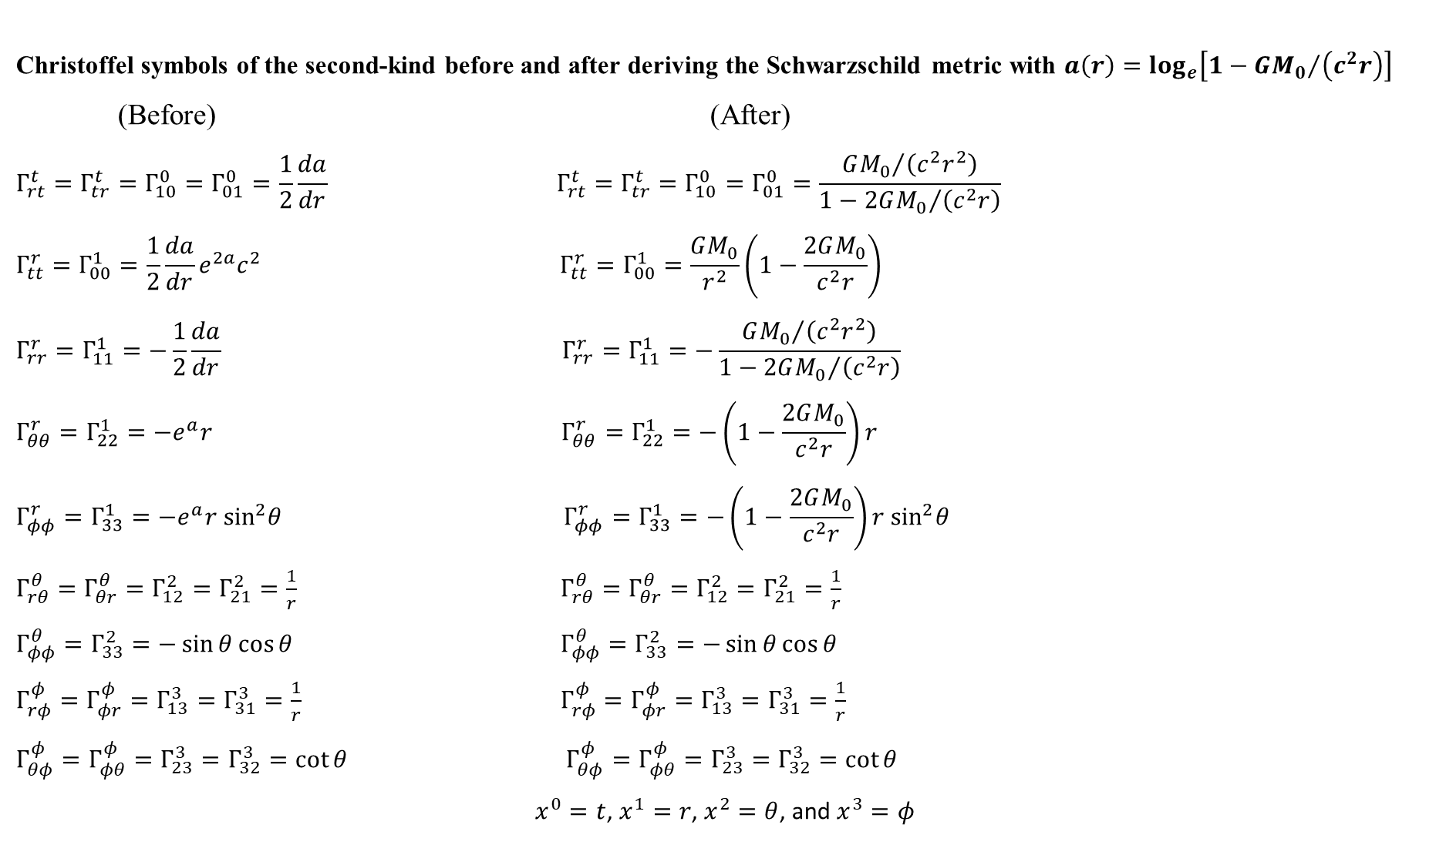
Christoffel symbols of the second-kind before and after deriving the Schwarzschild metric with $a\left(r\right)=\log_{e}\left[1−{GM_{0}}/{\left(c^{2}r\right)}\right]$
(Before) (After)
$$Γ_{rt}^{t}=Γ_{tr}^{t}=Γ_{10}^{0}=Γ_{01}^{0}=\frac{1}{2}\frac{da}{dr} Γ_{rt}^{t}=Γ_{tr}^{t}=Γ_{10}^{0}=Γ_{01}^{0}=\frac{{GM_{0}}/{\left(c^{2}r^{2}\right)}}{1−{2GM_{0}}/{\left(c^{2}r\right)}}$$
$$Γ_{tt}^{r}=Γ_{00}^{1}=\frac{1}{2}\frac{da}{dr}e^{2a}c^{2} Γ_{tt}^{r}=Γ_{00}^{1}=\frac{GM_{0}}{r^{2}}\left(1−\frac{2GM_{0}}{c^{2}r}\right)$$
$$Γ_{rr}^{r}=Γ_{11}^{1}=−\frac{1}{2}\frac{da}{dr} Γ_{rr}^{r}=Γ_{11}^{1}=−\frac{{GM_{0}}/{\left(c^{2}r^{2}\right)}}{1−{2GM_{0}}/{\left(c^{2}r\right)}}$$
$$Γ_{θθ}^{r}=Γ_{22}^{1}=−e^{a}r Γ_{θθ}^{r}=Γ_{22}^{1}=−\left(1−\frac{2GM_{0}}{c^{2}r}\right)r$$
$$Γ_{φφ}^{r}=Γ_{33}^{1}=−e^{a}r \sin^{2}θ Γ_{φφ}^{r}=Γ_{33}^{1}=−\left(1−\frac{2GM_{0}}{c^{2}r}\right)r \sin^{2}θ$$
$Γ_{rθ}^{θ}=Γ_{θr}^{θ}=Γ_{12}^{2}=Γ_{21}^{2}=\frac{1}{r}$ $Γ_{rθ}^{θ}=Γ_{θr}^{θ}=Γ_{12}^{2}=Γ_{21}^{2}=\frac{1}{r}$
$Γ_{φφ}^{θ}=Γ_{33}^{2}=−\sin{θ}\cos{θ}$ $Γ_{φφ}^{θ}=Γ_{33}^{2}=−\sin{θ}\cos{θ}$
$Γ_{rφ}^{φ}=Γ_{φr}^{φ}=Γ_{13}^{3}=Γ_{31}^{3}=\frac{1}{r}$ $Γ_{rφ}^{φ}=Γ_{φr}^{φ}=Γ_{13}^{3}=Γ_{31}^{3}=\frac{1}{r}$
$Γ_{θφ}^{φ}=Γ_{φθ}^{φ}=Γ_{23}^{3}=Γ_{32}^{3}=\cot{θ}$ $Γ_{θφ}^{φ}=Γ_{φθ}^{φ}=Γ_{23}^{3}=Γ_{32}^{3}=\cot{θ}$
$x^{0}=t$, $x^{1}=r$, $x^{2}=θ$, and $x^{3}=φ$

Slide 17
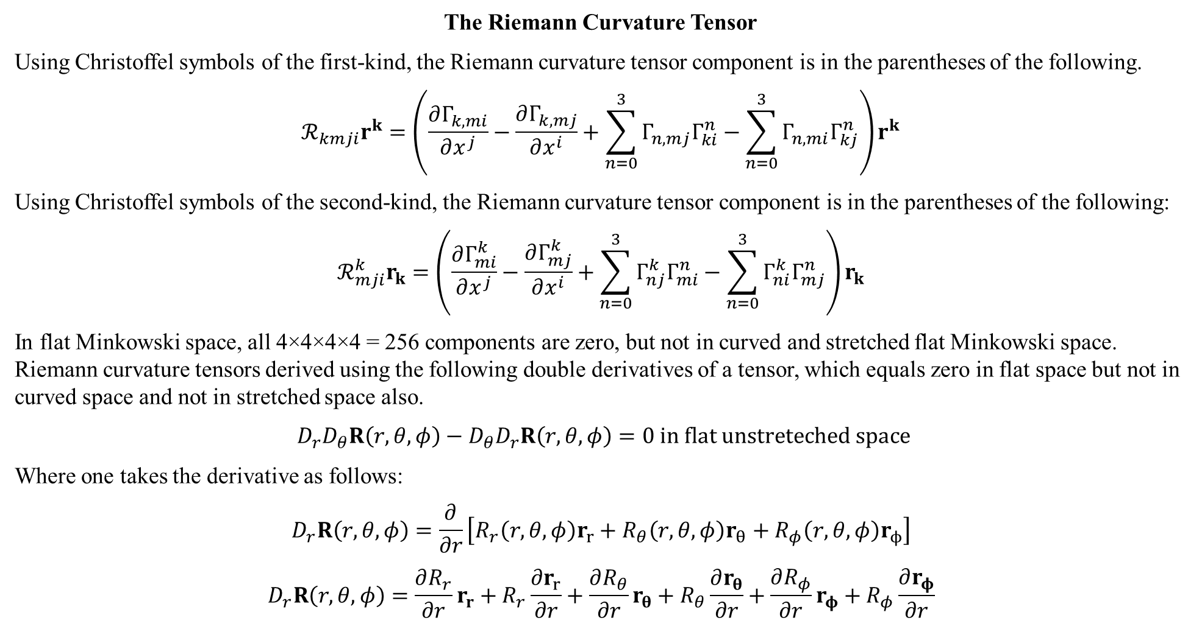
The Riemann Curvature Tensor
Using Christoffel symbols of the first-kind, the Riemann curvature tensor component is in the parentheses of the following.
$$ℛ_{kmji}r^{k}=\left(\frac{∂Γ_{k,mi}}{∂x^{j}}−\frac{∂Γ_{k,mj}}{∂x^{i}}+\sum_{n=0}^{3}{Γ_{n,mj}Γ_{ki}^{n}}−\sum_{n=0}^{3}{Γ_{n,mi}Γ_{kj}^{n}}\right)r^{k}$$
Using Christoffel symbols of the second-kind, the Riemann curvature tensor component is in the parentheses of the following:
$$ℛ_{mji}^{k}r_{k}=\left(\frac{∂Γ_{mi}^{k}}{∂x^{j}}−\frac{∂Γ_{mj}^{k}}{∂x^{i}}+\sum_{n=0}^{3}{Γ_{nj}^{k}Γ_{mi}^{n}}−\sum_{n=0}^{3}{Γ_{ni}^{k}Γ_{mj}^{n}}\right)r_{k}$$
In flat Minkowski space, all 4×4×4×4 = 256 components are zero, but not in curved and stretched flat Minkowski space. Riemann curvature tensors derived using the following double derivatives of a tensor, which equals zero in flat space but not in curved space and not in stretched space also.
$D_{r}D_{θ}R\left(r,θ,φ\right)−D_{θ}D_{r}R\left(r,θ,φ\right)=0 in flat unstreteched space$
Where one takes the derivative as follows:
$$D_{r}R\left(r,θ,φ\right)=\frac{∂}{∂r}\left[R_{r}\left(r,θ,φ\right)r_{r}+R_{θ}\left(r,θ,φ\right)r_{θ}+R_{φ}\left(r,θ,φ\right)r_{ϕ}\right]$$
$$D_{r}R\left(r,θ,φ\right)=\frac{∂R_{r}}{∂r}r_{r}+R_{r}\frac{∂r_{r}}{∂r}+\frac{∂R_{θ}}{∂r}r_{θ}+R_{θ}\frac{∂r_{θ}}{∂r}+\frac{∂R_{φ}}{∂r}r_{φ}+R_{φ}\frac{∂r_{φ}}{∂r}$$

Slide 18
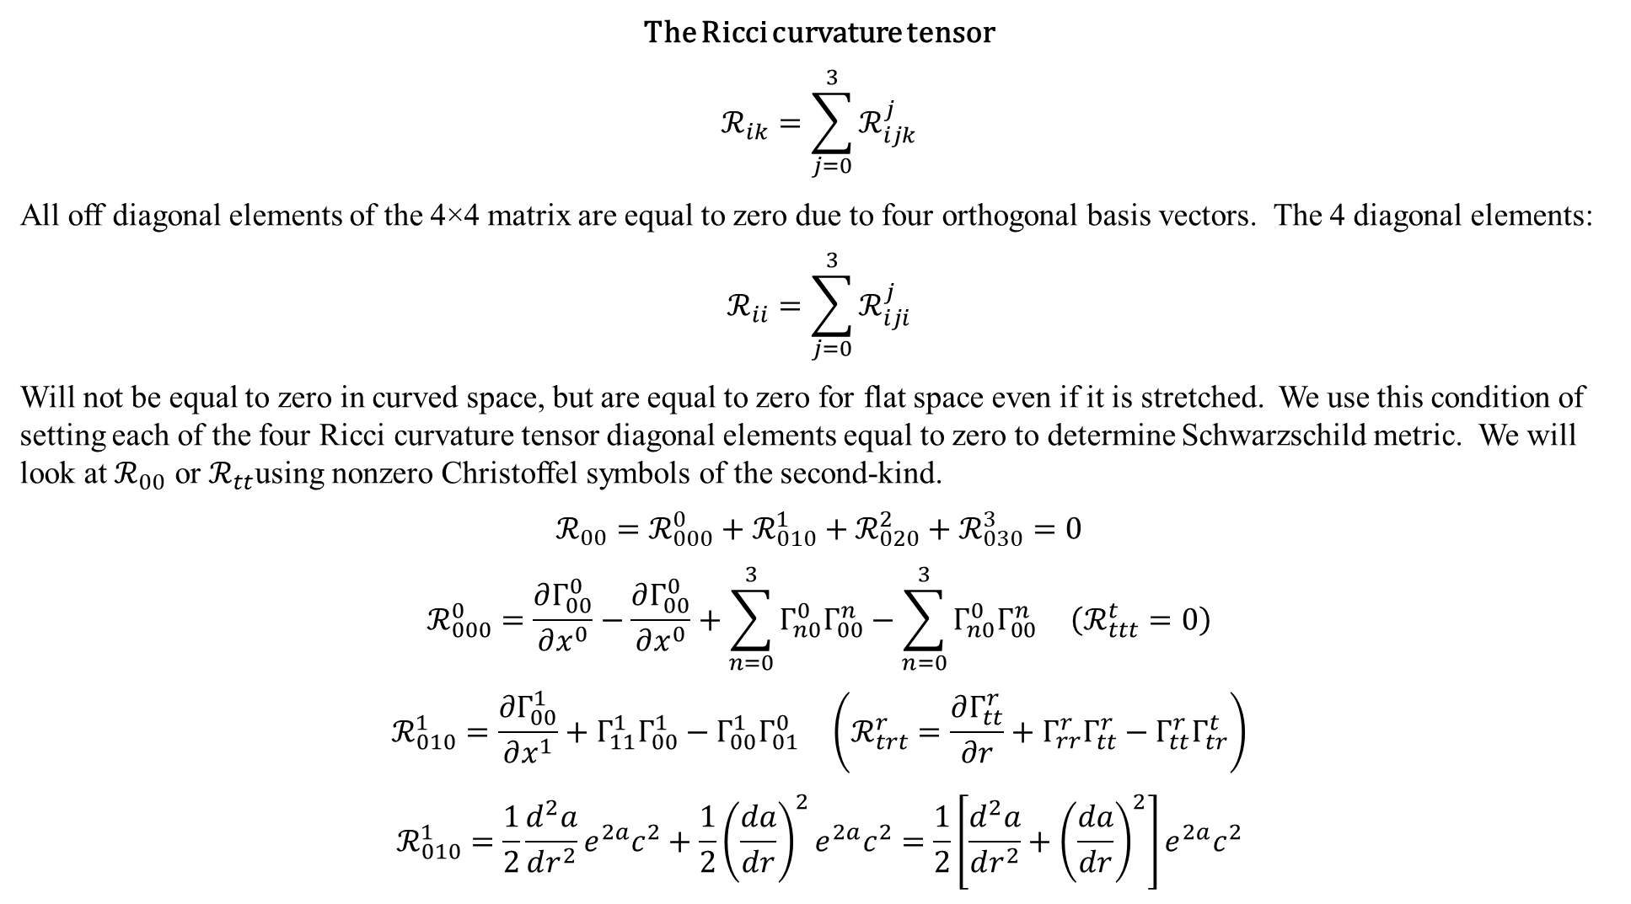
The Ricci curvature tensor
$$ℛ_{ik}=\sum_{j=0}^{3}{ℛ_{ijk}^{j}}$$
All off diagonal elements of the 4×4 matrix are equal to zero due to four orthogonal basis vectors. The 4 diagonal elements:
$$ℛ_{ii}=\sum_{j=0}^{3}{ℛ_{iji}^{j}}$$
Will not be equal to zero in curved space, but are equal to zero for flat space even if it is stretched. We use this condition of setting each of the four Ricci curvature tensor diagonal elements equal to zero to determine Schwarzschild metric. We will look at $ℛ_{00}$ or $ℛ_{tt}$using nonzero Christoffel symbols of the second-kind.
$$ℛ_{00}=ℛ_{000}^{0}+ℛ_{010}^{1}+ℛ_{020}^{2}+ℛ_{030}^{3}=0$$
$$ℛ_{000}^{0}=\frac{∂Γ_{00}^{0}}{∂x^{0}}−\frac{∂Γ_{00}^{0}}{∂x^{0}}+\sum_{n=0}^{3}{Γ_{n0}^{0}Γ_{00}^{n}}−\sum_{n=0}^{3}{Γ_{n0}^{0}Γ_{00}^{n}} \left(ℛ_{ttt}^{t}=0\right)$$
$$ℛ_{010}^{1}=\frac{∂Γ_{00}^{1}}{∂x^{1}}+Γ_{11}^{1}Γ_{00}^{1}−Γ_{00}^{1}Γ_{01}^{0} \left(ℛ_{trt}^{r}=\frac{∂Γ_{tt}^{r}}{∂r}+Γ_{rr}^{r}Γ_{tt}^{r}−Γ_{tt}^{r}Γ_{tr}^{t}\right)$$
$$ℛ_{010}^{1}=\frac{1}{2}\frac{d^{2}a}{dr^{2}}e^{2a}c^{2}+\frac{1}{2}{\left(\frac{da}{dr}\right)}^{2}e^{2a}c^{2}=\frac{1}{2}\left[\frac{d^{2}a}{dr^{2}}+{\left(\frac{da}{dr}\right)}^{2}\right]e^{2a}c^{2}$$

Slide 19
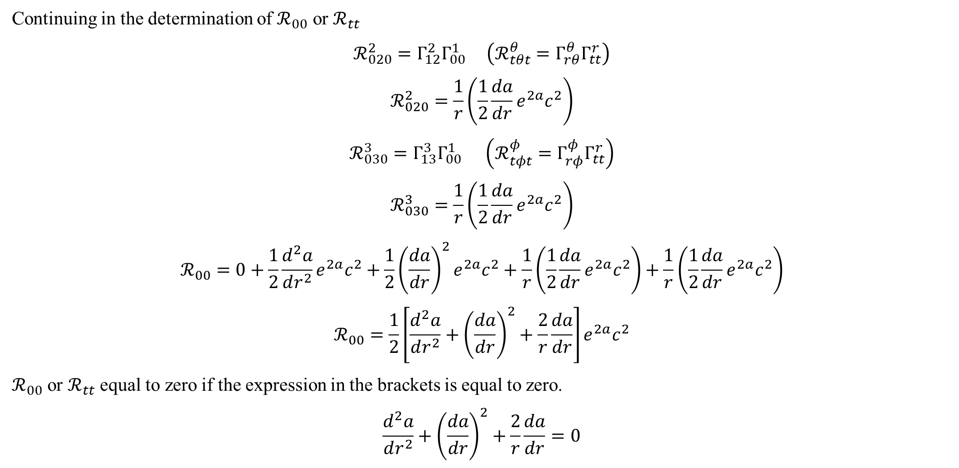
Continuing in the determination of $ℛ_{00}$ or $ℛ_{tt}$
$$ℛ_{020}^{2}=Γ_{12}^{2}Γ_{00}^{1} \left(ℛ_{tθt}^{θ}=Γ_{rθ}^{θ}Γ_{tt}^{r}\right)$$
$$ℛ_{020}^{2}=\frac{1}{r}\left(\frac{1}{2}\frac{da}{dr}e^{2a}c^{2}\right)$$
$$ℛ_{030}^{3}=Γ_{13}^{3}Γ_{00}^{1} \left(ℛ_{tφt}^{φ}=Γ_{rφ}^{φ}Γ_{tt}^{r}\right)$$
$$ℛ_{030}^{3}=\frac{1}{r}\left(\frac{1}{2}\frac{da}{dr}e^{2a}c^{2}\right)$$
$$ℛ_{00}=0+\frac{1}{2}\frac{d^{2}a}{dr^{2}}e^{2a}c^{2}+\frac{1}{2}{\left(\frac{da}{dr}\right)}^{2}e^{2a}c^{2}+\frac{1}{r}\left(\frac{1}{2}\frac{da}{dr}e^{2a}c^{2}\right)+\frac{1}{r}\left(\frac{1}{2}\frac{da}{dr}e^{2a}c^{2}\right)$$
$$ℛ_{00}=\frac{1}{2}\left[\frac{d^{2}a}{dr^{2}}+{\left(\frac{da}{dr}\right)}^{2}+\frac{2}{r}\frac{da}{dr}\right]e^{2a}c^{2}$$
$ℛ_{00}$ or $ℛ_{tt}$ equal to zero if the expression in the brackets is equal to zero.
$$\frac{d^{2}a}{dr^{2}}+{\left(\frac{da}{dr}\right)}^{2}+\frac{2}{r}\frac{da}{dr}=0$$

Slide 20
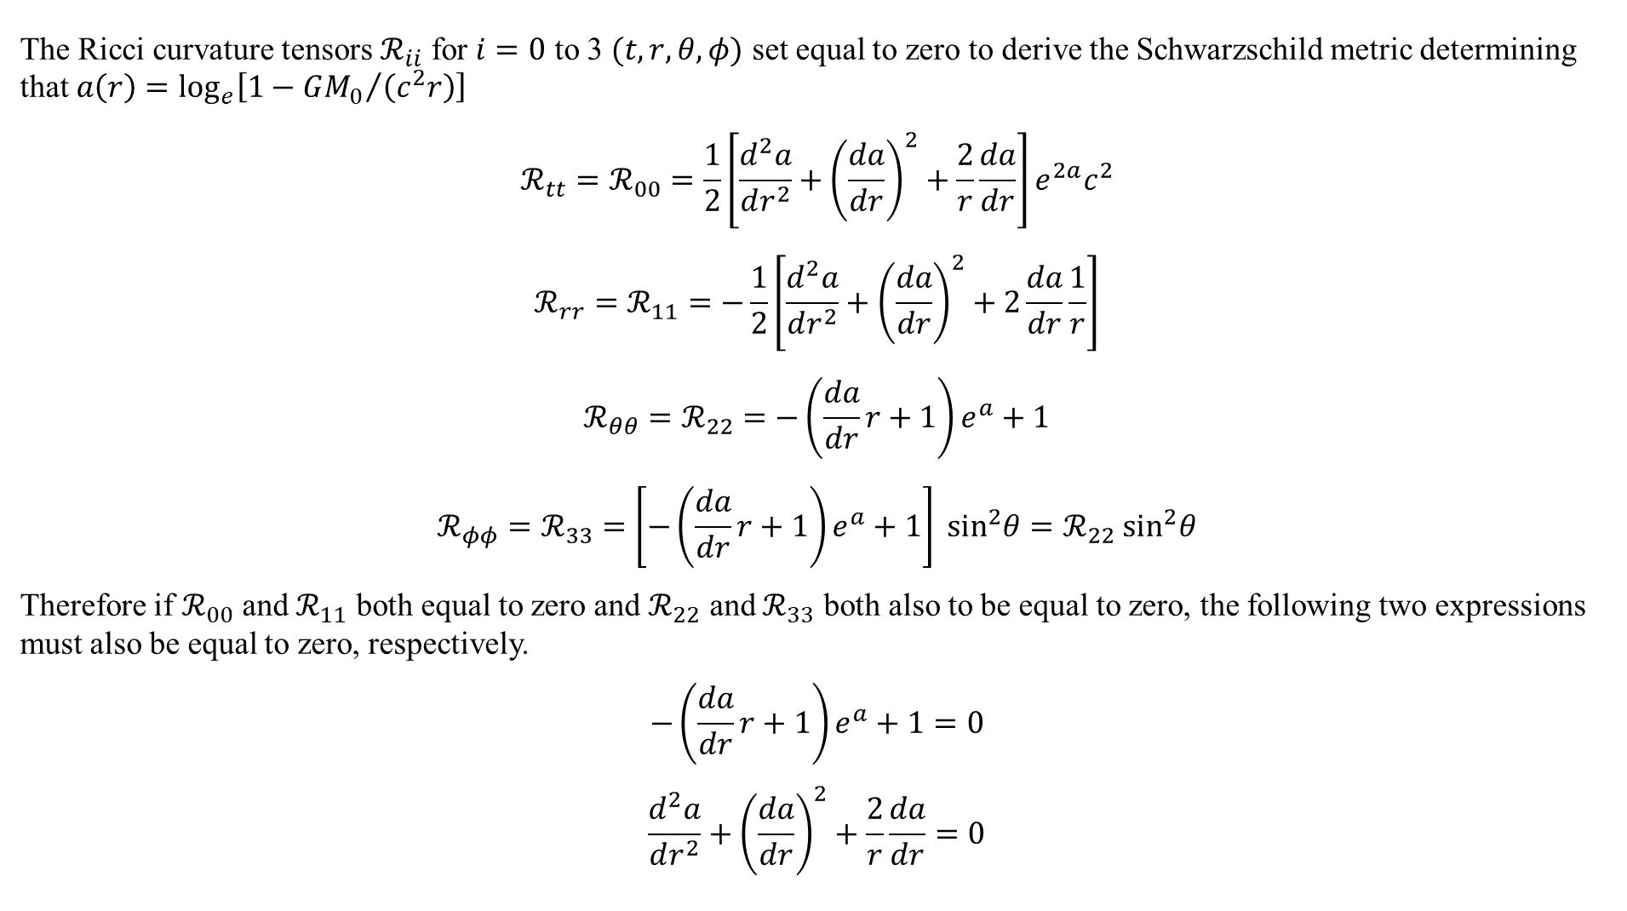
The Ricci curvature tensors $ℛ_{ii}$ for $i=0$ to 3 $(t,r,θ,φ)$ set equal to zero to derive the Schwarzschild metric determining that $a\left(r\right)=\log_{e}\left[1−{GM_{0}}/{\left(c^{2}r\right)}\right]$
$$ℛ_{tt}=ℛ_{00}=\frac{1}{2}\left[\frac{d^{2}a}{dr^{2}}+{\left(\frac{da}{dr}\right)}^{2}+\frac{2}{r}\frac{da}{dr}\right]e^{2a}c^{2}$$
$$ℛ_{rr}=ℛ_{11}=−\frac{1}{2}\left[\frac{d^{2}a}{dr^{2}}+{\left(\frac{da}{dr}\right)}^{2}+2\frac{da}{dr}\frac{1}{r}\right]$$
$$ℛ_{θθ}=ℛ_{22}=−\left(\frac{da}{dr}r+1\right)e^{a}+1$$
$$ℛ_{φφ}=ℛ_{33}=\left[−\left(\frac{da}{dr}r+1\right)e^{a}+1\right]\sin^{2}θ=ℛ_{22}\sin^{2}θ$$
Therefore if $ℛ_{00}$ and $ℛ_{11}$ both equal to zero and $ℛ_{22}$ and $ℛ_{33}$ both also to be equal to zero, the following two expressions must also be equal to zero, respectively.
$$−\left(\frac{da}{dr}r+1\right)e^{a}+1=0$$
$$\frac{d^{2}a}{dr^{2}}+{\left(\frac{da}{dr}\right)}^{2}+\frac{2}{r}\frac{da}{dr}=0$$

Slide 21
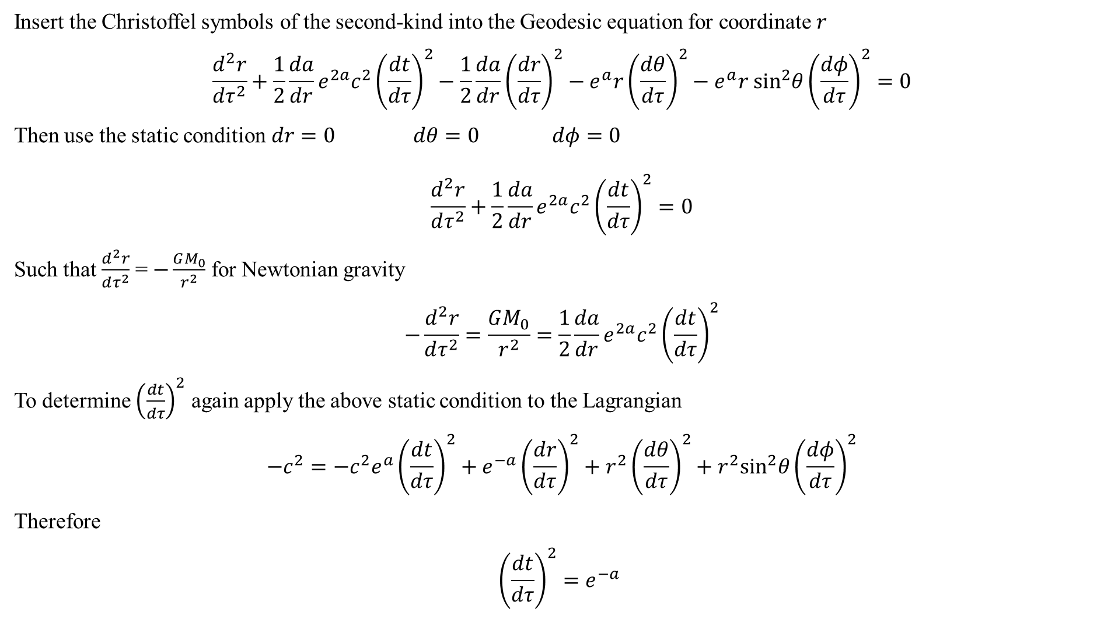
Insert the Christoffel symbols of the second-kind into the Geodesic equation for coordinate $r$
$$\frac{d^{2}r}{dτ^{2}}+\frac{1}{2}\frac{da}{dr}e^{2a}c^{2}{\left(\frac{dt}{dτ}\right)}^{2}−\frac{1}{2}\frac{da}{dr}{\left(\frac{dr}{dτ}\right)}^{2}−e^{a}r{\left(\frac{dθ}{dτ}\right)}^{2}−e^{a}r \sin^{2}θ{\left(\frac{dφ}{dτ}\right)}^{2}=0$$
Then use the static condition $dr=0 dθ=0 dφ=0$
$$\frac{d^{2}r}{dτ^{2}}+\frac{1}{2}\frac{da}{dr}e^{2a}c^{2}{\left(\frac{dt}{dτ}\right)}^{2}=0$$
Such that $\frac{d^{2}r}{dτ^{2}}$ = $−\frac{GM_{0}}{r^{2}}$ for Newtonian gravity
$$−\frac{d^{2}r}{dτ^{2}}=\frac{GM_{0}}{r^{2}}=\frac{1}{2}\frac{da}{dr}e^{2a}c^{2}{\left(\frac{dt}{dτ}\right)}^{2}$$
To determine ${\left(\frac{dt}{dτ}\right)}^{2}$ again apply the above static condition to the Lagrangian
$$−c^{2}=−c^{2}e^{a}{\left(\frac{dt}{dτ}\right)}^{2}+e^{−a}{\left(\frac{dr}{dτ}\right)}^{2}+r^{2}{\left(\frac{dθ}{dτ}\right)}^{2}+r^{2}\sin^{2}θ{\left(\frac{dφ}{dτ}\right)}^{2}$$
Therefore
$${\left(\frac{dt}{dτ}\right)}^{2}=e^{−a}$$

Slide 22
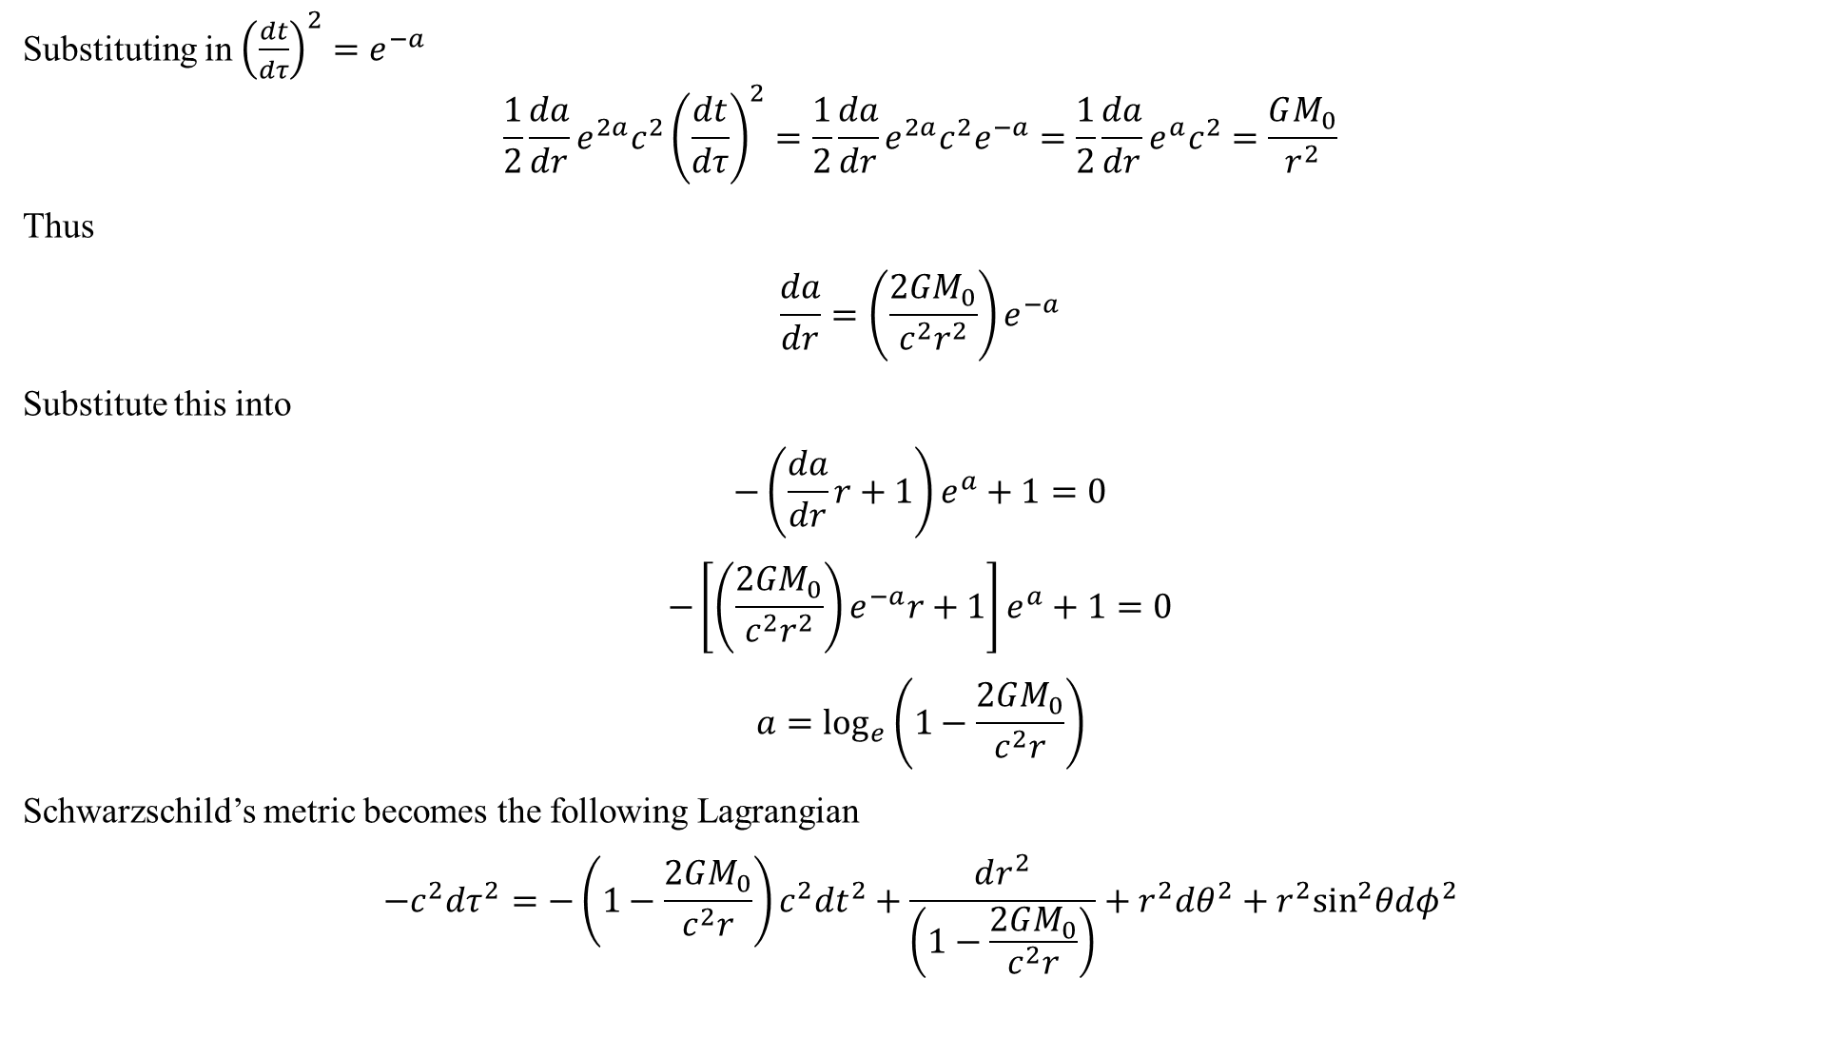
Substituting in ${\left(\frac{dt}{dτ}\right)}^{2}=e^{−a}$
$$\frac{1}{2}\frac{da}{dr}e^{2a}c^{2}{\left(\frac{dt}{dτ}\right)}^{2}=\frac{1}{2}\frac{da}{dr}e^{2a}c^{2}e^{−a}=\frac{1}{2}\frac{da}{dr}e^{a}c^{2}=\frac{GM_{0}}{r^{2}}$$
Thus
$$\frac{da}{dr}=\left(\frac{2GM_{0}}{c^{2}r^{2}}\right)e^{−a}$$
Substitute this into
$$−\left(\frac{da}{dr}r+1\right)e^{a}+1=0$$
$$−\left[\left(\frac{2GM_{0}}{c^{2}r^{2}}\right)e^{−a}r+1\right]e^{a}+1=0$$
$$a=\log_{e}\left(1−\frac{2GM_{0}}{c^{2}r}\right)$$
Schwarzschild’s metric becomes the following Lagrangian
$$−c^{2}dτ^{2}=−\left(1−\frac{2GM_{0}}{c^{2}r}\right)c^{2}{dt}^{2}+\frac{dr^{2}}{\left(1−\frac{2GM_{0}}{c^{2}r}\right)}+r^{2}dθ^{2}+r^{2}\sin^{2}θdφ^{2}$$

Slide 23
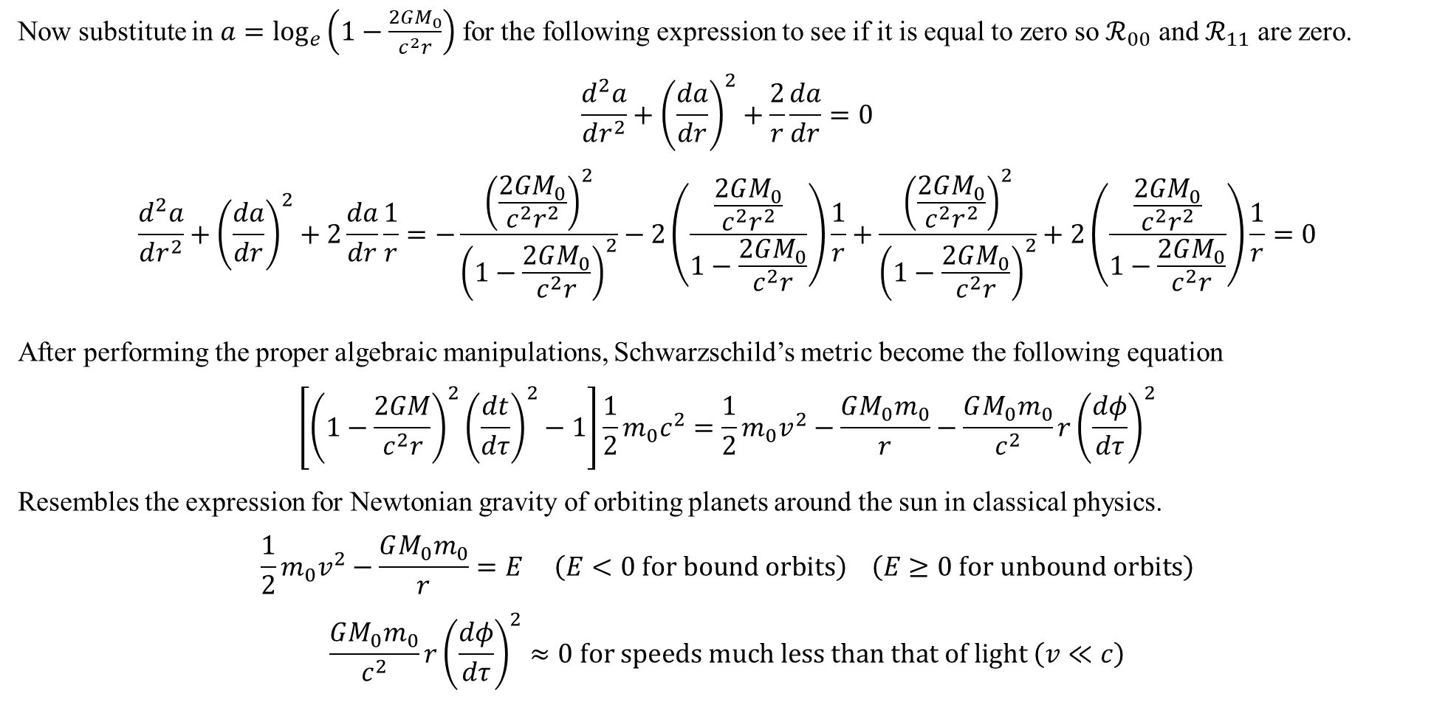
Now substitute in $a=\log_{e}\left(1−\frac{2GM_{0}}{c^{2}r}\right)$ for the following expression to see if it is equal to zero so $ℛ_{00}$ and $ℛ_{11}$ are zero.
$$\frac{d^{2}a}{dr^{2}}+{\left(\frac{da}{dr}\right)}^{2}+\frac{2}{r}\frac{da}{dr}=0$$
$$\frac{d^{2}a}{dr^{2}}+{\left(\frac{da}{dr}\right)}^{2}+2\frac{da}{dr}\frac{1}{r}=−\frac{{\left(\frac{2GM_{0}}{c^{2}r^{2}}\right)}^{2}}{{\left(1−\frac{2GM_{0}}{c^{2}r}\right)}^{2}}−2\left(\frac{\frac{2GM_{0}}{c^{2}r^{2}}}{1−\frac{2GM_{0}}{c^{2}r}}\right)\frac{1}{r}+\frac{{\left(\frac{2GM_{0}}{c^{2}r^{2}}\right)}^{2}}{{\left(1−\frac{2GM_{0}}{c^{2}r}\right)}^{2}}+2\left(\frac{\frac{2GM_{0}}{c^{2}r^{2}}}{1−\frac{2GM_{0}}{c^{2}r}}\right)\frac{1}{r}=0$$
After performing the proper algebraic manipulations, Schwarzschild’s metric become the following equation
$$\left[{\left(1−\frac{2GM}{c^{2}r}\right)}^{2}{\left(\frac{dt}{dτ}\right)}^{2}−1\right]\frac{1}{2}m_{0}c^{2}=\frac{1}{2}m_{0}v^{2}−\frac{GM_{0}m_{0}}{r}−\frac{GM_{0}m_{0}}{c^{2}}r{\left(\frac{dφ}{dτ}\right)}^{2}$$
Resembles the expression for Newtonian gravity of orbiting planets around the sun in classical physics.
$$\frac{1}{2}m_{0}v^{2}−\frac{GM_{0}m_{0}}{r}=E \left(E<0 for bound orbits\right) \left(E≥0 for unbound orbits\right)$$
$$\frac{GM_{0}m_{0}}{c^{2}}r{\left(\frac{dφ}{dτ}\right)}^{2}≈0 for speeds much less than that of light \left(v≪c\right)$$

